Slide 1
Trapped-bubble records of concentrations of trace gases involved in global biogeochemical cycles
Esther Pischel

Slide 2
How does air become trapped?
Snow falls and accumulates
Porous top layer exchanges air with the atmosphere
Snow densifies at depth (50 – 150 m) and traps gas

Slide 3
But…
The age of the air trapped in the ice is not the same as the ice itself

Slide 4
Since air can freely exchange with the atmosphere in the porous upper zone of the ice sheet, it has a younger age than the ice itself
This age can be determined using steady-state or dynamic models
Age difference is a function of temperature and snow accumulation rate
Value is referred to as the gas age-ice age difference, or “∆ age”
Gas age timescale obtained by subtracting ∆ age from ice age timescale

Slide 5
Another method for assessing gas age-ice age differences is a technique based on the principle of thermal diffusion, which fractionates gas mixtures in a temperature gradient according to their mass
Heavier δ¹⁵N is concentrated with increasing depth
Gases can be compared directly with gases, enabling a precise determination of the relative time of local temperature changes and atmospheric gas changes

Slide 6
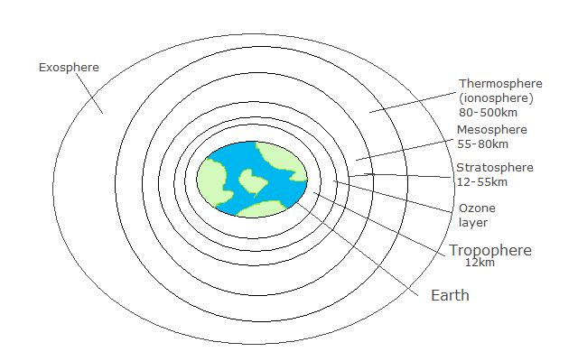
The trapped gas measured in Alley et al. is methane, CH₄
Methane is used as a global climate proxy because the troposphere is well-mixed on decadal time scales
Image source: http://chemwiki.ucdavis.edu/Inorganic_Chemistry/Case_Study:_Contrasting_Earth,_Mars_and_the_Moon's_Atmosphores

Slide 7
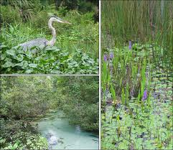
Methane typically produced in an anaerobic environment generally associated with wetlands
Modern wetlands’ methane emissions depend on
Temperature
Hydrologic balance
Net ecosystem productivity
Warm, wet, and highly productive conditions are associated with higher methane emissions
In ice cores:
More methane = warmer
Less methane = cooler
Image source: http://wetlandsolutionsinc.com/

Slide 8
References:
Alley, R.B., Mayewski, P.A., Sowers, T., Stuiver, M., Taylor, K.C., and Clark, P.U., 1997, Holocence climatic instability: A prominent, widespread event 8200 yr ago, Geology, v. 25, no. 6, 3 p.
Brook, E.J, Harder, S., Severinghaus, J., Steig, E.J., and Sucher, C.M., 2000, On the origin and timing of rapid changes in atmospheric methane during the last glacial period, Global Biogeochemical Cycles, v. 14, no. 12, 13 p.
Schwander, J., Sowers, T., Barnola, J.M., Blunier, T., Fuchs, A. and Malaize, B., 1997, Age scale of the air in the summit ice: Implication for glacial-interglacial temperature change, Journal of Geophysical Research, v. 102, no. D16, 10 p.
Severinghaus, J.P., Sowers, T., Brook, E.J., Alley, R.B., and Bender, M.L., 1998, Nature, v. 391, 5p.
Sowers, T., Bender, M., Raynaud, D., and Korotkevich, Y.S., 1992, d¹⁵N of N₂ in air trapped in polar ice: A tracer of gas transport in the firn and a possible constraint on ice age-gas age differences, Journal of Geophysical Research, v. 97, no. D14, 14 p.

