Slide 1
The 8.2 ka BP cold Event
Presentation: Liz Westby
Assistant: Esther Duggan
October 30, 2012

Slide 2
Description

Slide 3
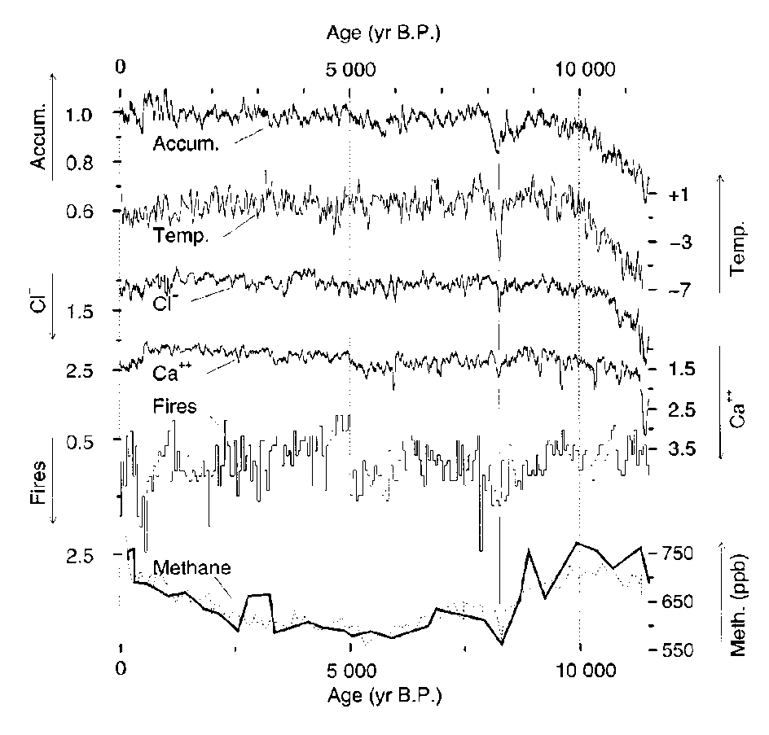
GISP2 Ice Core
Identified in lacustrine sedimentary sequences in northern Sweden in 1976 (Head, 2007); found in Greenland ice core
Background climate was “stable” when --
  Temperature dropped by 4–8° C in central Greenland, 1.5–3°C at marine and terrestrial sites around the northeastern North Atlantic Ocean (Barber, 1999)
    Snow accumulation decreased
    Precipitation of chemical impurities increased, forest fires more frequent (Clarke, 2003)
    The event lasted for 100-200 years (Clarke, 2003)
  Largest abrupt climate change in the last 10,000 years (Kobashia et al., 2007)
Alley et al., 1997

Slide 4
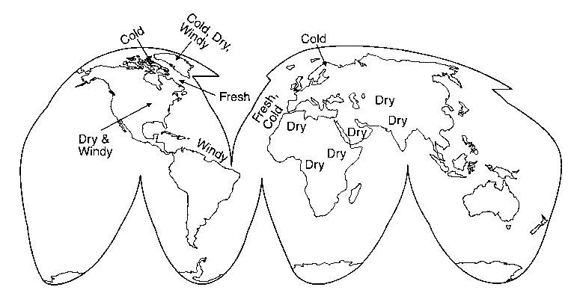
A Near-Global Event
Cooling in North America, with drying in the US Great Plains
European region experienced strong cooling
Weakened Asian Monsoon (from
speleothems of Dongge Cave, southern China)
Southward shift of
the ITCZ inferred from the Cariaco Basin record
Alley et al., 1997
Sahara experienced drying

Slide 5
Questions to Address
Is this a synchronous event?
  Evidence from ice cores
What triggered the event?
  Freshwater forcing
What was the impact of the event?
  THC sensitivity
Uncertainties?
  Lack of uniform record

Slide 6
Ice Core Record

Slide 7
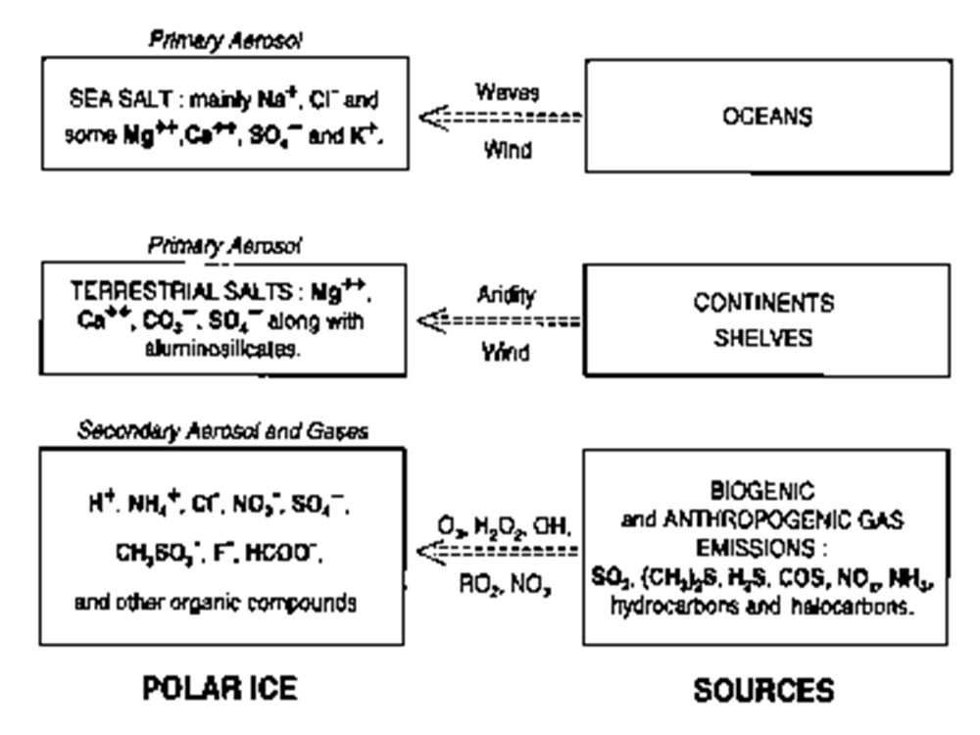
Ice Core Records
Local Conditions
  Temperature (¹⁸O)
  Snow accumulation (layer thickness)
Regional
  Wind-blown sea salt (Cl⁻)
  Continental dust (Ca²⁺)
Hemispheric or Global
  Trapped-gas bubble records (methane)
Legrand and Mayewski, 1997

Slide 8
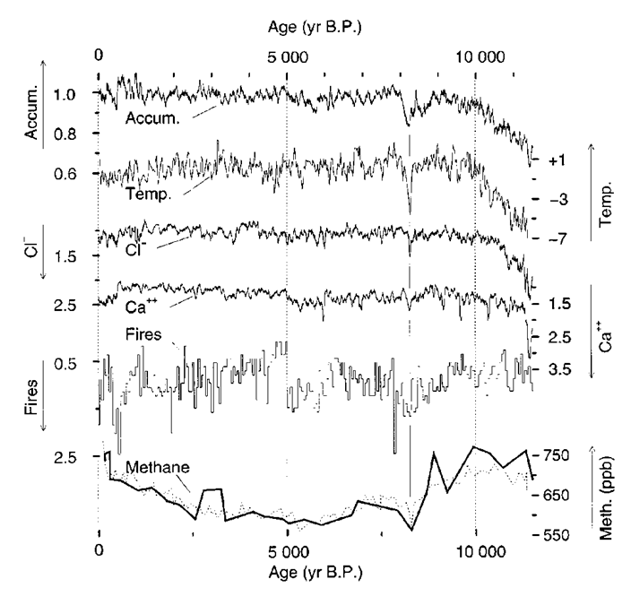
Revisit Alley’s Figure 1 GISP2
Decrease in snow accumulation
Decrease in temperature
Increase in Cl⁻
Increase in CA²⁺
Oscillating NO₃⁻
Decrease in methane
Together, cold, dry, and dusty
Alley et al., 1997

Slide 9
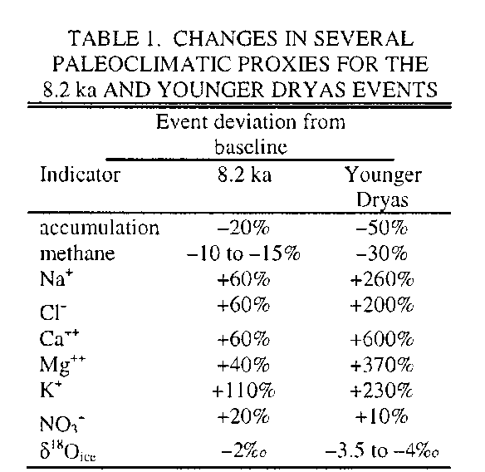
Similarities to Younger Dryas
Compare to baseline
  8 ka and 8.4 ka (8.2 ka Event)
  Early Preboreal (YD)
Movement in same directions
Magnitudes off
YD sustained for a millennium
8.2 ka lasts for ~150 years
Alley et al., 1997

Slide 10
Same Trigger as YD?
Younger Dryas may have been triggered by an outburst of waters from a large ice-dammed lake and sustained by the redirection of meltwater from the Mississippi to the St. Lawrence Valley (Clarke, 2003)

Slide 11
Freshwater Forcing

Slide 12
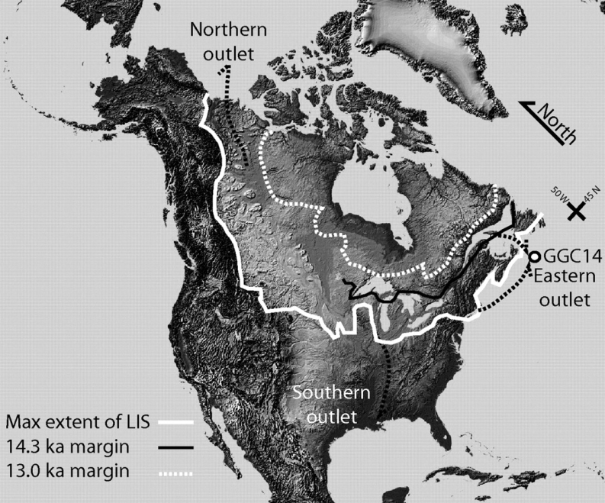
Laurentide
Around 8.5 ka BP
  3 km thick dome
  Area of Hudson Bay to Labrador Sea (Clarke, 2003)
Disintegrating, calving into Hudson Bay (Clarke, 2003)
With northward retreat, land surface depressed, sloping north (Clarke, 2003)
Obbink et al., 2010

Slide 13
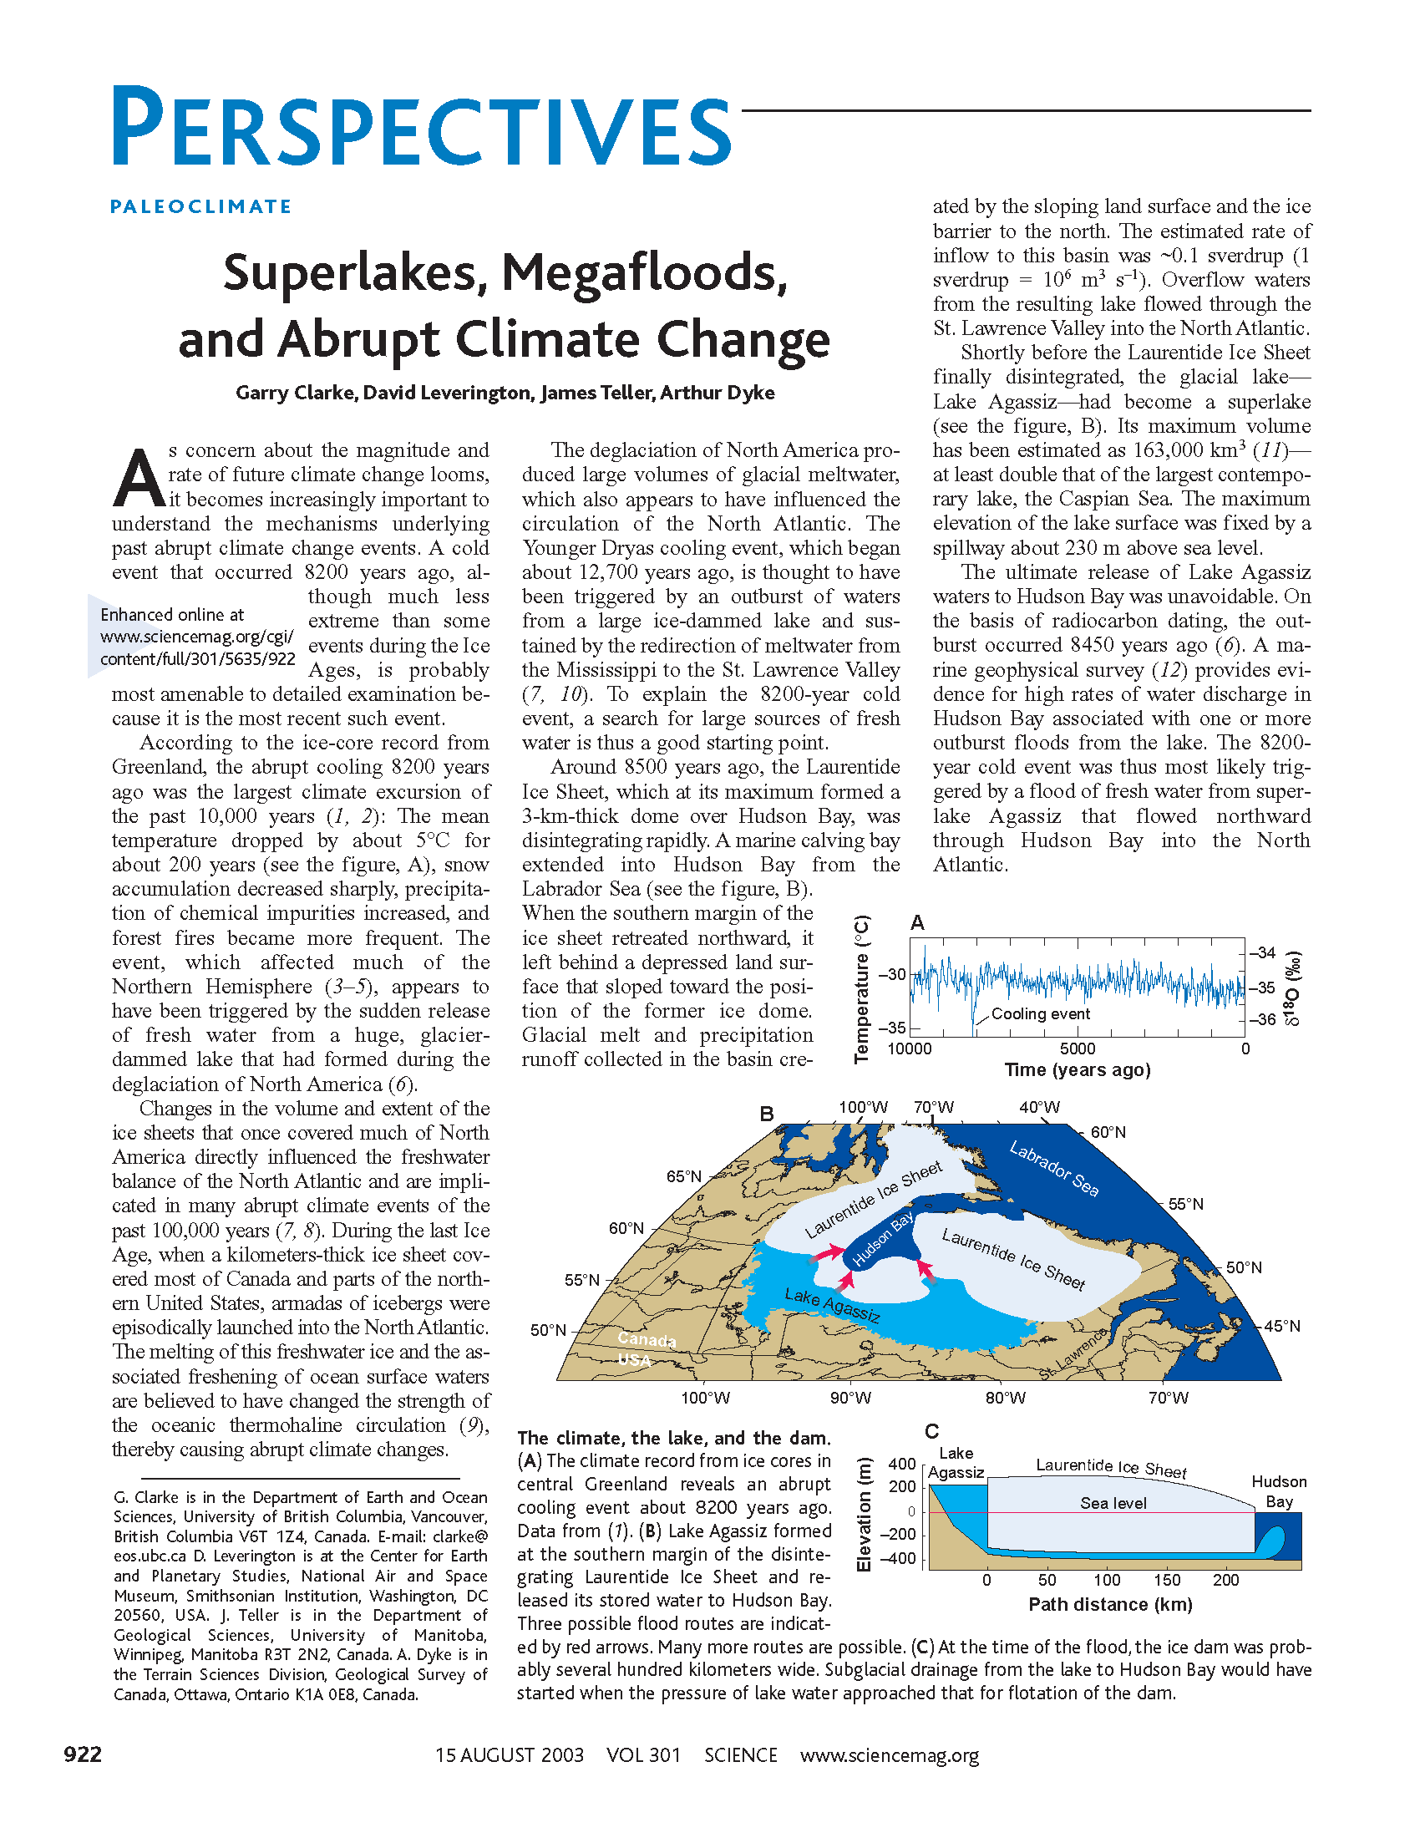
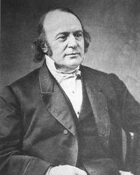
Lake Agassiz
Clarke et al., 2003
Discharge of ~0.1 Sv to St. Lawrence Valley

Slide 14
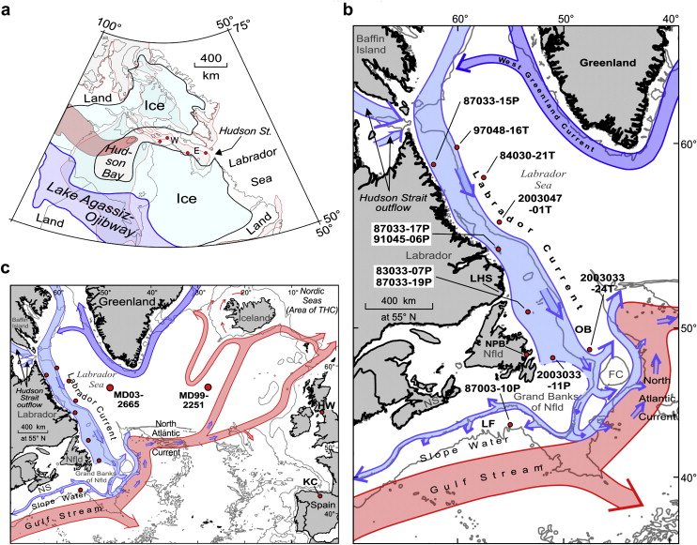
Outburst
Northward outburst 8.450 ka BP
Marine geophysical surveys support high rates of water discharge in Hudson Bay associated with one or more outburst floods
  megaripple sand-wave bed forms
  arcuate scours on floor of Hudson Bay (Clarke, 2003)
Hematite-rich rocks from the northern part of Hudson Bay are thought to be the source of red clay marker beds within Hudson Strait (Keigwin et al., 2005)
  Oldest marine mollusk around Hudson Bay ~8.45 ka
Modern outburst analogs found in Iceland but not so big (Clarke, 2003)

Slide 15
Mechanics
Clarke et al., 2003
Water establishes a subglacial path
Conduit grows by melting, stays open as long as water pressure exceeds overburden pressure
Following an outburst, flood channel either remains open (smaller diameter) or reseals so that lake level rises until a subsequent flood is released (Clarke, 2004)

Slide 16
Discharge
Glacial Lake Agassiz-Lake Ojibway
  ~163,000 km³ in volume
  ~841,000 km² in areal extent prior to the final release of lake (Leverington, 2002)
Actual discharge uncertain
  Estimates from 1.2 x 10¹⁴ m³ (0.012 Sv) to 5 x 10¹⁴ m³ (0.05 Sv)
  Duration of the meltwater pulse ranges from 0.5 to 500 years (Renssen, 2001)

Slide 17
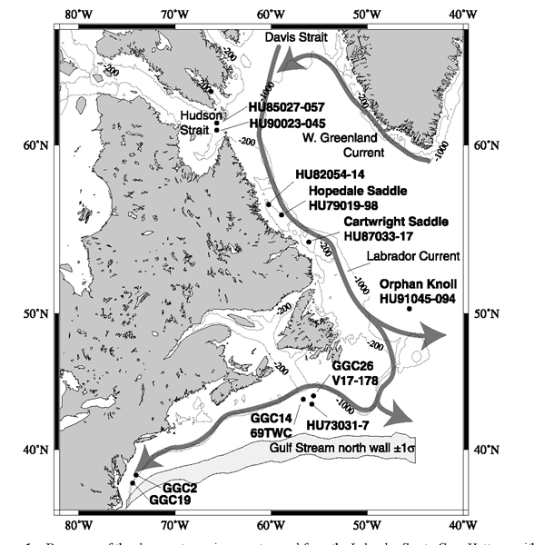
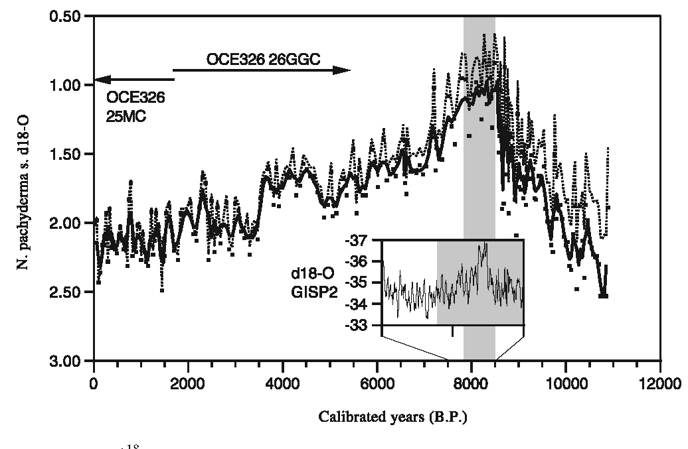
Marine Cores: GGC26
Increase in abundance of N. pachyderma
Carbon isotope ratios of C. wuellerstorfi low enough to indicate significantly decreased NADW production at several times in the Holocene, including 8.2 ka.
Not all cores show same trends
Keigwin et al., 2003
Keigwin et al., 2003

Slide 18
Effect on Climate
Outburst causes a slowdown of the meridional overturning circulation, which enabled wintertime sea ice cover to expand with consequent hemispheric cooling and drying, especially surrounding the North Atlantic area (Kobashia et al., 2007)

Slide 19
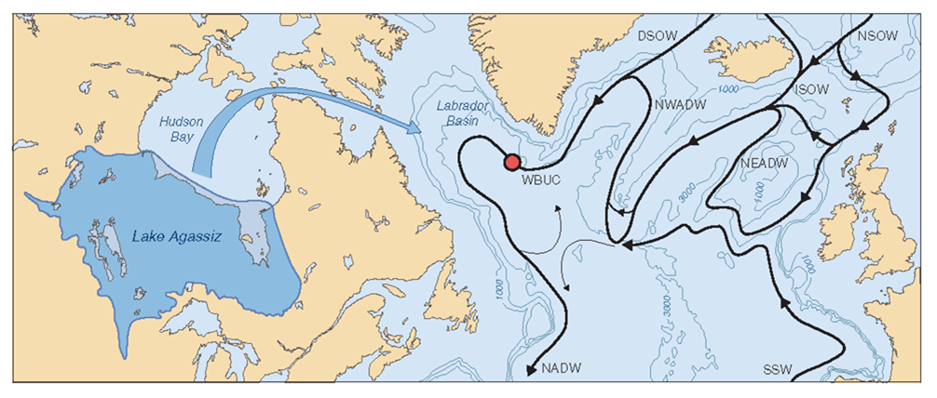
Response Lag
Kleiven et al., 2008
Event occurs 8.4 ka but cold event peaks at 8.2 ka.
Why didn’t ocean respond immediately to outburst?
Outburst event longer? 500 years?
Stronger flux of Atlantic water towards north – had a higher capacity to remove freshwater and replace it with more salty water? (Klitgaard-Kristensen, 1998)

Slide 20
THC Sensitivity

Slide 21
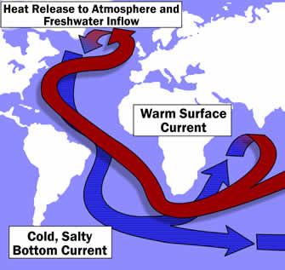
THC
Warm surface water flows north, releases heat, sinks, and flows south as cold deep water
Volume of transport is about 17 ±4 Sv (1 Sv = 10⁶ m³s⁻¹)
Circulation in the North Atlantic driven by sensitive density balance between salinity, temperature and influx of freshwater
http://www.lmvp.org/Waterline/winter2003/thermohaline.htm

Slide 22
GCM Suggests Sensitivity
General circulation model (GCM) by Geophysical Fluid Dynamics Laboratory in Princeton suggest NADW circulation is highly sensitive to freshwater forcing
  Some models project enhanced freshwater fluxes to North Atlantic will slow or stop deep water formation if maintained long enough
    0.015 Sv delivered to the Labrador Sea sufficient to stop convection in one model (Alley et al., 1997)
    NADW circulation winds down with an input of less than 0.06 Sv into the catchment area of the North Atlantic (Rahmstorf, 1995)
May collapse if a certain threshold is exceeded and can show hysteresis behavior

Slide 23
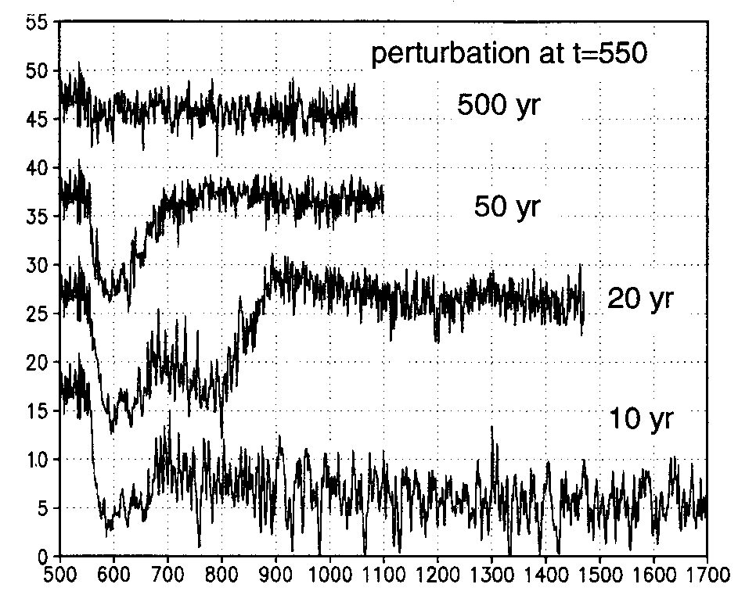
Renssen (2001) Model
Multiple freshwater experiments
Amount of freshwater constant at 4.67 x 10¹⁴ m³ (~0.05 Sv)
Timing of release varies
20-year release likely trigger to 8.2 ka event
Renssen, 2001

Slide 24
Wiersma (2011) Model
ECBilt-CLIO-VECODE (version 3)
  3-D climate model of intermediate complexity consisting of an atmospheric, sea-ice ocean and vegetation component with free-surface ocean general circulation model coupled to a comprehensive sea ice model with a representation of both thermodynamic and dynamic processes

Slide 25
Wiersma Results
Freshwater forcing in Labrador Sea produced a temperature anomaly over central Greenland in agreement with that observed during the 8.2 ka event
Detectable temperature response to a freshwater forcing is not synchronous, lags mostly in the order of decades
  Delayed response over Greenland of 30 years
  Simulation suggests a delay of more than 50 years of detectable cooling over Asia

Slide 26
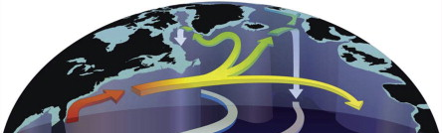
Results (cont.)
Lag due to an initial decadal warming
  brief westward shift of deep-water formation from just south of Svalbard to north of Iceland
  brings additional heat to Greenland (Wiersma, 2011, Renssen, 2001)
Substantial increase in sea-ice coverage, with most of the Nordic Seas and the Denmark Strait becoming perennially ice covered (Renssen, 2001)
Sea-ice cover causes a considerable cooling of the lower atmosphere over the Nordic Seas and adjacent landmasses (Renssen, 2001)

Slide 27
Other Evidence
Nova Scotia Lake Deposits
  Not conclusive – too short of an event/too subtle a signal? (Spooner, 2002)
Western Ireland Peat
  Dryer and cooler conditions in pollen record dated to 7740 yr BP and 7220 yr BP (Head, 2007) – dating errors?
Too few high-resolution records from the Southern Hemisphere to determine whether climate changed there (NOAA)

Slide 28
Alternatives to Freshwater Flux?
Millennial-scale cooling trend started a few centuries earlier than the 8.2 ka event (Kobashia et al., 2007)
A minor solar minimum coinciding with the 8.2 ka event, forcing the system to cross a threshold, triggering the 8.2 ka event (Kobashia et al., 2007)
Or…?

Slide 29
Relevance
Freshwater fluxes of similar magnitude may occur in future
  Global warming of 3°C in response to doubling atmospheric CO₂ could increase total freshwater flux from Greenland ice sheet by 0.02 Sv and maintain the level over centuries (Alley et al., 1997)
  Enhanced high latitude precipitation and sea ice melting in response to warming might cause an increase of similar magnitude in freshwater flux to North Atlantic (Alley et al., 1997)
Freshwater flux at the right time, right place could trigger abrupt climate change (Alley et al., 1997)

Slide 30
References
Alley, R.B., Mayewski, P.A., Sowers, T., Stuiver, M., Taylor K.C., Clark P.U., 1997, Holocene climate instability: A prominent, widespread event 8200 yr ago: Geology v. 25, n. 6, p. 483-486.
Barber, D. C., Dyke, A., Hillaire-Marcel, C., Jennings, A. E., Andrews, J. T., Kerwin, M. W., Bilodeau, G., McNeely, R., Southon, J., Morehead, M. D., Gagnon, J. M., 1999, Forcing of the cold event of 8,200 years ago by catastrophic drainage of Laurentide lakes: Nature v. 400, p. 344–348.
Clarke, G., Leverington, D. W., Teller, J. T., Dyke, A. S., 2004, Paleohydraulics of the last outburst flood from glacial Lake Agassiz and the 8200 BP cold event: Quaternary Science Reviews v. 23, p. 389–407
Clarke, G., Leverington, D., Teller, J., Dyke, A., 2003, Superlakes, Megafloods, and Abrupt Climate Change: Science v. 301, p. 922-923.
Head, K., Turney, C.S.M., Pilcher, J.R., Palmer, J.G., Baillie, M.G.L., 2007, Problems with identifying the ‘8200-year cold event’ in terrestrial records of the Atlantic seaboard: a case study from Dooagh, Achil Island, Ireland: Journal of Quaternary Science v. 22, n. 1, p. 65-75.
Keigwin, L. D., Sachs, J. P., Rosenthal, Y., Boyle, E. A., 2005, The 8200 year BP event in the slope water system, western subpolar North Atlantic: Paleoceanography v. 20, p. 1–14.
Kleiven, H.F., Kissel, C., Laj, C., Ninnemann, U.S., Richter, T.O., Cortijo, E., 2008, Reduced North Atlantic Deep Water Coeval with the Glacial Lake Agassiz Freshwater Outburst: Science v. 319, p. 60–64.
Klitgaard-Kristensen, D., Sejrup, H. P., Haflidason, H., Johnsen, S., Spurk, M., 1998, A regional 8200 cal. yr BP cooling event in northwest Europe, induced by final stages of the Laurentide ice-sheet deglaciation? Journal of Quaternary Science v. 13, p. 165–169.
Kobashia, T., Severinghaus, J. P., Brook, E. J., Barnolac, J., Grachev, A. M., 2007, Precise timing and characterization of abrupt climate change 8200 years ago from air trapped in polar ice: Quaternary Science Reviews v. 26, p. 1212–1222.
Legrand, M., Mayewski, P. A., 1997, Glaciochemistry of polar ice cores: A review: DigitalCommons@UMaine, available at http://digitalcommons.library.umaine.edu/cgi/viewcontent.cgi?article=1276&context=ers_facpub, accessed 10/28/2012.
Leverington, D. W., Mann, J. D., Teller, J. T., 2002, Changes in the Bathymetry and Volume of Glacial Lake Agassiz between 9200 and 7700 14C yr B.P.: Quaternary Research v. 57, p. 244–252.
NOAA National Climatic Data Center, 2008, Post-glacial cooling 8,200 Years Ago, available at http://www.ncdc.noaa.gov/paleo/abrupt/data5.html, accessed 10/27/2012.
Rahmstorf, S., 1995, Bifurcations of the Atlantic thermohaline circulation in response to changes in the hydrological cycle: Nature v. 378, p. 145–149.
Renssen, H., Goosse, H., Fichefet, T., Campin, J.M., 2001, The 8.2 kyr BP event simulated by a global atmosphere-sea-ice-ocean model: Geophysical Research Letters, v. 28, n. 8, p. 1567-1570.
Spooner, I., Douglas, M.S.V., Terrusi, L., 2002, Multiproxy evidence of an early Holocene (8.2 kyr) climate oscillation in central Nova Scotia, Canada: Journal of Quaternary Science v. 7, n. 17, p. 639-645.

