Slide 1

Younger Dryas
Leader: Kelly Hughes
Assistant: Liz Westby
G610: The Holocene
23OCT2012
Notes:
Younger Dryas named after

Slide 2
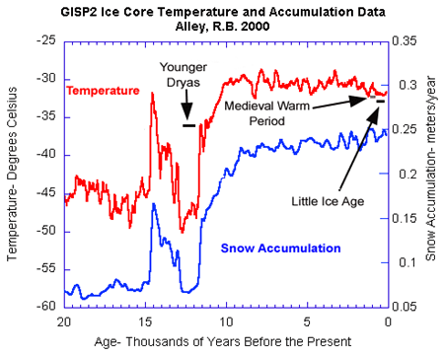
Younger Dryas (~ 12.8 – 11.5 ka)
Cold period in Arctic (GS1)
Abrupt start and end
Notes:
GS1 = Greenland Stadial 1.
This graph was produced from data collected from the Greenland Ice Sheet Project II core; temp estimates from δ¹⁸O proxy
Relative snow accum rates can be estimated from the relative thickness of seasonally resolved annual layers in an ice core; absolute rates like in the above graph must include correction for flow thinning. Because ice on the east side of Greenland flows east, that on the west side flows west, and no crevasse opens in the middle, layers must be progressively stretched and thinned as they are buried. Ice flow can be complicated by factors like topography, burial depth, the thickness and shape of the ice sheet (surface slope), and basal velocity. Flow corrections used in the models to estimate the snow accum can handle these complications, and for Greenland in particular, some of these potential complications are negligible (i.e. frozen to the bed during LGM = zero basal velocity, the surface slope is effectively constant for central Greenland). The uncertainty in flow corrections is basically zero for young ice. (Alley, 2000)
For the GISP2 site in central Greenland, the accumulation rate doubled at the end of the Younger Dryas, from approximately 0.07±0.01 to 0.14±0.02 m ice/yr, with the change in one to a few years. An additional increase of 50–100% after the Younger Dryas brought accumulation to the modern 0.24 m ice/yr (Cuffey and Clow, 1997).
Notice that snow accum follows a very similar trend as does temp.
“Temperature and snow accumulation are related in many places on ice sheets, with warming increasing water content of the air and so snowfall. The “usual” assumption in Greenland is that accumulation increases ≈4%/°C warming (Johnsen et al., 1989; Oerlemans, 1991), which is equivalent to assuming that precipitation is extracted from throughout the troposphere proportional to the saturation vapor pressure. Huybrechts et al. (1991) used a slightly higher sensitivity of 5.3%/°C. Higher sensitivities up to 10%/°C might be possible if precipitation were extracted solely from the base of the troposphere (Kapsner et al., 1995).The warming of 5–10°C at the end of the Younger Dryas occurred with a doubling of snow accumulation. Taking the 5–10°C warming at face value, and using 4% increase per degree warming, would yield an accumulation-rate increase of 22–48%. Sensitivity of 7% per degree and the maximum warming of 10°C would be required to explain the doubling of accumulation. Because the temperature change applies to the surface, and free-tropospheric changes are likely to have been only about 2/3 of the surface change (Cuffey et al., 1995), this indicates that it is difficult or impossible to explain the accumulation-rate change solely based on warming (Kapsner et al., 1995). “Storminess” apparently increased in central Greenland as the Younger Dryas ended.” (Alley 2000)

Slide 3
Younger Dryas-Holocene Transition
Taylor et al (1997) Hypothesis:
  Most of transition occurred over ~200 yr period; 11.79 ka – 11.6 ka
  Increased atmospheric water vapor across N.H., as suggested by increase of methane source areas
    ⬆ water vapor due to change in ocean circulation
    ⬆ retention of long-wave radiation
    Stabilized transition to new climate state
      From cold & dry to warm & wet

Slide 4
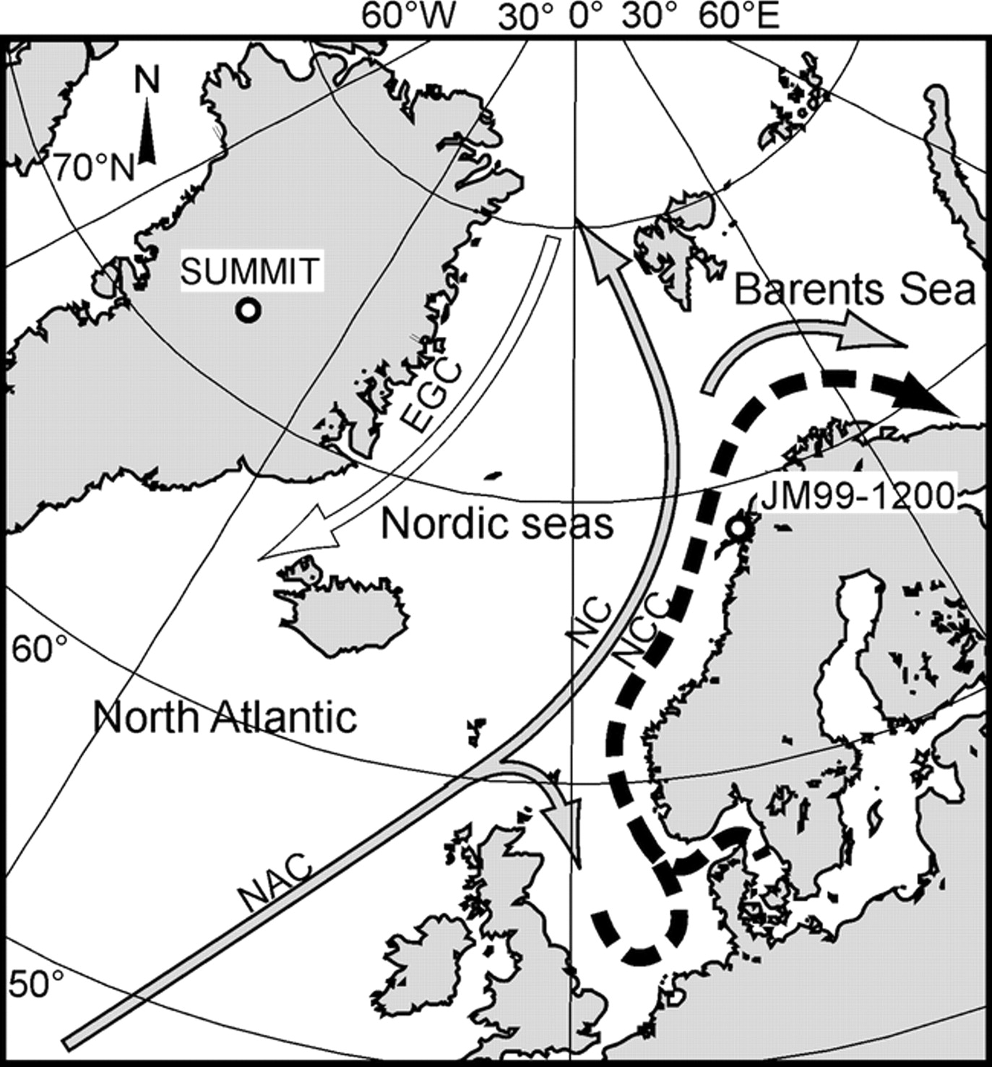

Location of Summit, Greenland
Figure 1. from Ebbesen & Hald, 2004
Ebbesen H , Hald M Geology 2004;32:673-676
©2004 by Geological Society of America
Notes:
Borrowed Figure 1 from Ebbesen & Hald, 2004 to show the location of Summit, Greenland. GISP2 core was drilled at Summit, which is central Greenland (inland/Continental) and should be noted as such for the following analyses.

Slide 5
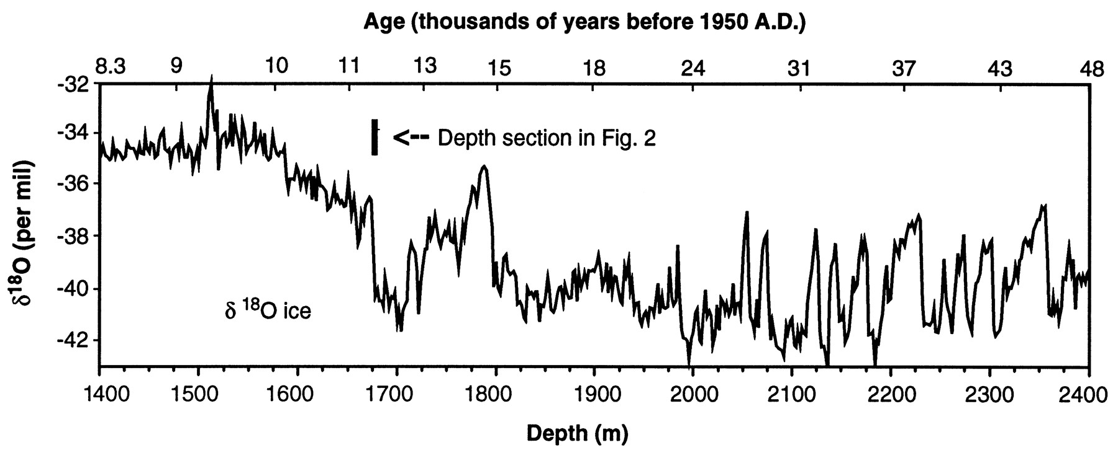

Figure 1. The GISP2 δ18O ice record (1) for a 40,000-year period at the end of the Wisconsin and start of the Holocene, plotted on a linear depth scale.
K C Taylor et al. Science 1997;278:825-827
Published by AAAS
Notes:
The GISP2 δ¹⁸O ice record (1) for a 40,000-year period at the end of the Wisconsin and start of the Holocene, plotted on a linear depth scale. The corresponding ages are on the top scale. The time period discussed in this report, and presented in Fig. 2, is indicated by the bar.

Slide 6
Proxies Used
δ¹⁸O: colder temperatures = enrichment of ¹⁸O (heavy isotope) in ocean and depletion of it in ice sheets
δD: colder temperatures = less ²H (D) in ice as well
Deuterium Excess = δD - 8δ¹⁸O; variation contains information about climate of moisture source
Measurement techniques:
    mass spectrometry (adv – high res & accurate, disadv – labor intensive & costly)
    Picarro laser absorption (adv – high res & can be done in field, disadv – less accurate than MS)
Notes:
In general, there are less of the heavy isotopes 18O and 2H (also called deuterium, or D) in ice formed under cold conditions. The amount missing is very small, and for practical reasons, the measured amounts of 18O or 2H are given as the so-called δ18O (delta-O-eighteen) and δD (delta-Deuterium) values. These values are usually negative and range roughly from -80‰ to 0‰ for δ18O and from -600‰ to 0‰ for δD. One per mille of δ18O (or 8‰ of δD) corresponds to a temperature difference of 1.5-4°C. (
“But the isotopes also tell about the climatic conditions in the areas from which the moisture source originates; equilibrium fractionation. Roughly speaking, the δD values are 8 times the δ18O values because the relative mass difference between D and 1H is 8 times bigger than the mass difference between 18O and 16O. However, the difference δD - 8 ⋅ δ18O (called the Deuterium excess) varies and also carries information about the climate conditions of the moisture sources. So while the individual δ¹⁸O and δD records tell about local temperatures, small differences between the two records tell about moisture source temperatures.” (http://www.iceandclimate.nbi.ku.dk/research/past_atmos/past_temperature_moisture/isotopes_reveal/)
“At the end of the …[Younger Dryas]…the climate changed in many ways. Essentially all the parameters measured on the ice core samples change from glacial to interglacial values over a century, but the Deuterium excess measurements were very special: the shift from glacial to interglacial values happened within 1-3 years, and in a way that surprised the researchers: the measurements tell that the temperature of the source areas dropped at a time when the glacial was ending and the World was warming.” (http://www.iceandclimate.nbi.ku.dk/research/past_atmos/past_temperature_moisture/isotopes_reveal/)
The source is a low-pressure chamber into which the introduced sample or standard gas is ionized by an electron beam produced by a hot filament. After formation, the ions are accelerated and focused by charged plates into a beam that enters a vacuum flight tube.
The fast moving ions pass through a magnetic field that curves their trajectories. The trajectories with highest mass/charge ratio are curved less than those with lower mass/charge ratio, and the ion beam is there separated into distinct beams.
The intensities of these beams are then measured by collectors. The measurements yield the abundances of ions with different mass/charge ratios. (http://www.iceandclimate.nbi.ku.dk/research/drill_analysing/cutting_and_analysing_ice_cores/isotope_measurement/mass_spectrometry/)
**Couldn’t access the sources to find out which technique was used for the oxygen and deuterium isotopic analyses.

Slide 7
Proxies Used
Non-sea-salt sulfate (nssSO₄)
  Dominant source: oxidation of DMS from marine phytoplankton
  Alternative source: volcanic activity
Methanesulfonate (MSA or MS⁻)
  Dominant source: oxidation of DMS from marine phytoplankton
MSA fraction (MSAF) = MSA/(MSA + nssSO₄)
Sea-salt sodium (ssNa⁺)
    Wind speed and strength increased during winter/spring
Notes:
nssSO4 is calculated from measured concentrations of SO₄²⁻ and Na⁺, assuming that the sea salt component has the same sodium ion/sulfate ion weight ratio as seawater (0.2517).
MSA/nssSO4 ratios and MSAF are nearly equivalent at low-latitudes but in polar regions MSA can make-up a substantial fraction of total sulfur.
Na⁺, MSA, and nssSO₄ can also be used to estimate sea ice extent, as well as peaks in the ratios of Na⁺/SO₄^{2–} (winter) and SO₄^{2–}/Na⁺ (summer) can be used to distinguish annual layer; in general, increased Na⁺ correlates to increased ice volume in sea ice, increased MS⁻ correlates to increased open-water area (or inverse correlates to sea ice extent), and increased nssSO₄ correlates to decreased sea ice duration (Sneed, et al. A. Glaciology 2011; 52; 347-354)

Slide 8
Proxies Used
Direct current electrical conductivity method (ECM)
    Fast and high spatial resolution
    Measures the acidity of ice; detects volcanic influences
    Identifies annual layers
Particulate (Microparticle) Record
  Concentration & mean particle size:
    Coulter-counter method
    Influenced by wind speed and source changes, seasonally
Notes:
ECM is both fast (on the order of minutes for a meter of measurement), and has high spatial resolution (on the order of a few mm), and is therefore used in the field for continuous measurements to identify regions in the cores where more specific investigations would be beneficial. The detection of volcanic influences makes it a great tool for cross-correlating with other cores. Has been used for annual layer resolution for GISP1 and GISP2 cores. (Taylor, et al. J. Glaciology 1992; 38; 325-332)
Microparticle conc are influenced on longer timescales to the greatest extent by the availability of dust for eolian transport due to aridity, lack of stabilizing vegetation, and areal extent of source areas. (Zielinski, et al. GSA Bulletin; v.109; p. 547-559)

Slide 9
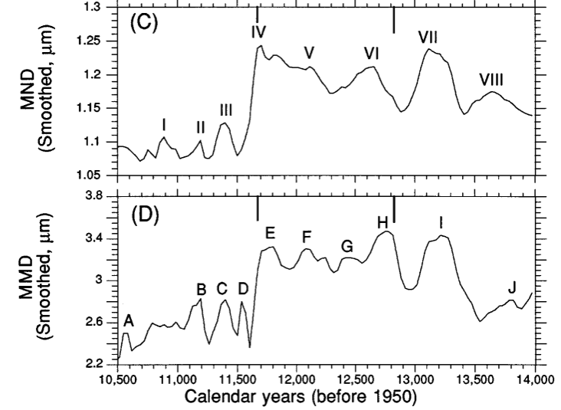
Mean Particle Size
Preboreal
Younger Dryas
Bølling-Allerød
Number-based
  Function of zonal wind strength
Mass-based
  Proxy of storminess
Notes:
Increased microparticle concentrations (numbers), mass, and mass flux values in the GISP2 ice core reflect greater aridity in source areas of the Northern Hemisphere, which enabled more dust to be transported to Greenland. This occurred when the polar vortex may have been more extensive (both spatially and temporally) during the colder climatic period of the Younger Dryas. Increased mean grain size (diameter) based on number (mean number diameter) probably was a function of greater transporting zonal wind strength (i.e., increased strength of the westerlies). Greater values in mean grain size based on mass (mean mass diameter) was controlled more by the largest particle sizes analyzed, which may be a proxy for increased storminess. (Zielinski, et al. GSA Bulletin; v.109; p. 547-559)

Slide 10
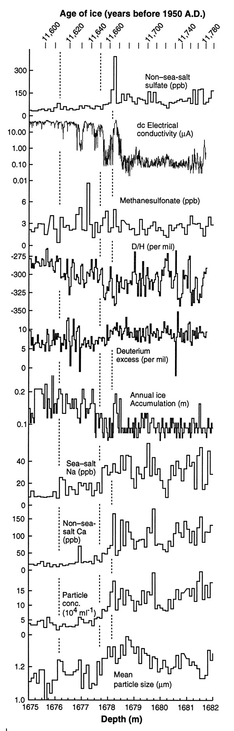
Figure 2. The Younger Dryas–Holocene transition as recorded in the GISP2 core.
Published by AAAS
K C Taylor et al. Science 1997;278:825-827
Notes:
The Younger Dryas–Holocene transition as recorded in the GISP2 core. All data are plotted with depth as a linear scale on the bottom of the plots. The corresponding ages are on the top scale. The dashed vertical lines are time horizons to facilitate comparison between plots.
In 11,660 B.P., the concentration of non–sea-salt sulfate (7) increased above background levels by a factor of 4 (100 ppb to 400 ppbfor <5 year. This excursion is unlikely to be associated with emissions of dimethylsulfide (DMS) from the sea surface, because there is no corresponding signal of methanesulfonate.
The elevated dc electrical conductivity corresponing to the nssSO₄ peak suggests that the anomalous sulfate was a strong acid, sulfuric acid (H₂SO₄). Since the elevated conductivity signal is also seen in GRIP and Dye-3 cores, collected 30 and 600 km away respectively, and since the δD signal suggests cooling at the summit, it can be justified that the sulfate excursion resulted from a volcanic eruption (either nearby, like in Iceland or Alaska, or possibly a large, explosive eruption elsewhere). Does the ~ 10 yr cooling at Summit indicated by the δD signal represent an event that tipped the climate scale to a warmer state? Taylor et al doesn’t think so, because there were 6 similar sulfate excursions from volcanic activity prior to the YD-Holocene transition that didn’t tip the scale. The coincident occurrence of the eruption and climate transition remains intriguing, however.
The Deuterium excess, more strongly influenced by isotopic composition of source water and evaporation along transport path than δD, began to decrease 11,660 ya and continued decreasing for 15 yrs. This decrease indicates a possible northward movement of the polar front, which moved the location of the moisture source area from a region of sea surface temp of ~ 25C to a more northern, colder location.

Slide 11
Figure 2. The Younger Dryas–Holocene transition as recorded in the GISP2 core.
K C Taylor et al. Science 1997;278:825-827
Published by AAAS
Notes:
The Younger Dryas–Holocene transition as recorded in the GISP2 core. All data are plotted with depth as a linear scale on the bottom of the plots. The corresponding ages are on the top scale. The dashed vertical lines are time horizons to facilitate comparison between plots.
The amount of non-sea-salt Ca and conc of insoluble particles decreased during the same time of D excess decrease. This suggests that an increase in moisture in non-Arctic source areas reduced the size of terrestrial dust source areas and increased the washout rate of airborne particles, OR decreased wind speed. During this 15-yr period, lack of change in sea-salt Na and mean particle size suggests that there was no notable change in the extent of sea ice, nor in the Arctic atmospheric transport processes. (Taylor et al. Science 1997; 278; p.825-827)

Slide 12
Figure 2. The Younger Dryas–Holocene transition as recorded in the GISP2 core.
K C Taylor et al. Science 1997;278:825-827
Published by AAAS
Notes:
The δD and snow accumulation rate increased abruptly, suggesting that the mean temp at Summit increased rapidly. The δD increasing several years before the accumulation rate possibly suggests that there was a short lag between warmer temps and the reduction in the distance to open ocean (lessening of sea ice extent). The increase in snow accumulation rate is in excess of the expectation associated with warming indicated by δD. The doubling of the snow accumulation rate may have been the results of the winters becoming sufficiently warm that greater amounts of winter snowfall occurred. Winter snow increase would cause the annual mean δD to give an underestimate of the true warming at this time. (K C Taylor et al. Science 1997;278:825-827)

Slide 13
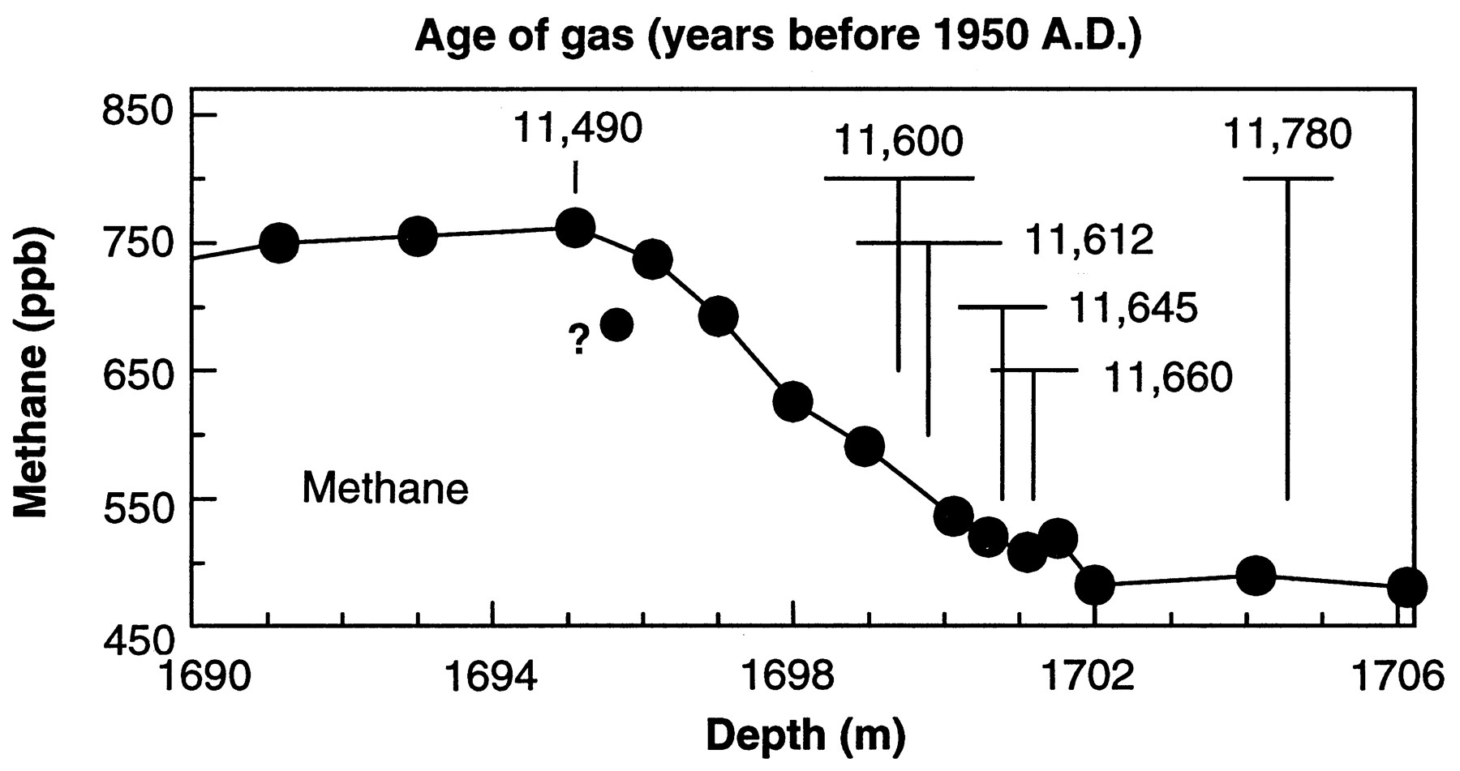
Figure 3. The GISP2 methane record from Brook, E. J., et al. Science 1996; 273: 1087-1091, obtained from measurements of discontinuous samples and plotted as a function of depth.
K C Taylor et al. Science 1997;278:825-827
Published by AAAS
Notes:
The GISP2 methane record (25), obtained from measurements of discontinuous samples and plotted as a function of depth. The solid vertical time lines correspond to the time lines in Fig. 2. The uncertainty in the age of the time lines relative to the age of the time lines in Fig. 2 is shown by the horizontal bars.
The trend of atmospheric methane during the transition from the Younger Dryas to the Holocene shows a fairly steady and fairly dramatic increase. A depth-based comparison between the gas and ice records is established by the assumption that the gas becomes trapped in the ice approximately 800 years after the ice surrounding it fell as snow. Within the dating uncertainty, and allowing for a lag between environmental changes and changes in methane production, the warming at Summit was approximately synchronous with the increase in temperatures and moisture in methane source areas. The widespread distribution of methane source areas indicates that the climate transition was rapid not just around Greenland but was also nearly synchronous over a large part of the terrestrial biosphere.

Slide 14
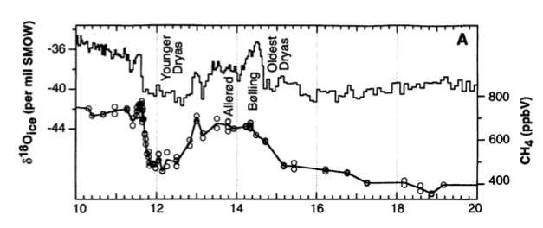
Figure 2. Expanded plots of the GISP2 methane and δ¹⁸O_{ice} records. (A) Data from 10 to 20 ka. All replicate methane measurements are shown as circles, and the solid line connecting them passes through the mean value for each depth. Thin solid line in upper half of each panel is δ¹⁸O_{ice} record from Grootes, P., et al. Nature 1993; 366: 552.
Notes:
Methane record from GISP2 ice core shows an increase during the Bolling/Allerod, a decline and steady low period during the Y.D. and then a subsequent dramatic increase again at the transition to the Holocene. Methane follows closely the deltaO18 trend for the transition into and out of the Younger Dryas. Actually, methane closely follows the temperature trend at the beginning of and during interstadial events from 110 ka until the present, which provides further evidence of a strong link between interstadial events observed in Greenland and the global methane budget.

Slide 15
Taylor et al Conclusion
The Y.D.-Holocene Transition was marked by:
  Hemisphere-wide increase in water vapor
  Decreased size of dust source areas
  Increased snow accumulation at Summit
  Wind speeds, precipitation, temperatures and sea ice changing on subdecadal time scales
Remaining question:
  Did the climate transition start at lower lats and changes at higher lats followed, or did higher lat changes occur earlier but were undetected?
K C Taylor et al. Science 1997;278:825-827
Notes:
Hemisphere-wide inc in water vapor is suggested by the increase in methane source areas, a decreased size of dust source areas, and increased snow accumulation at Summit. A majority of the climate signals were seen transitioning during a 50 yr period with wind speeds, precip, temp, and sea ice all changing on time scales less than 10 years long.
Other climate proxies associated with non-Arctic areas appear to have changed before climate proxies associated with Arctic areas. This difference suggests that some climate conditions changed outside of the Arctic and were followed by changes at higher latitudes. But, because the proxy records that are available are not sensitive all of the climate changes occurring in the Arctic, it is not clear if the climate transition started at lower latitudes or if earlier changes that we are unable to detect occurred in more northern regions.

Slide 16
Unstable Younger Dryas
Ebbesen & Hald (2004) Hypothesis:
  Y.D. stadial (GS1) was actually climatically unstable for NE North Atlantic
    Fluctuations between glacial values (2°C) and interglacial values (10°C)
    Instability is predicted by modeling experiments of GS1 where cooling was forced by meltwater, in contrast to what other proxy records from Greenland ice cores suggest
Ebbesen H , Hald M Geology 2004;32:673-676
Notes:
The general view of the GS1 is that it was a stable, cool period that started and ended very abruptly. But modeling experiments simulating a GS1 cooling with meltwater in the northern North Atlantic result in a major weakening of the North Atlantic thermohaline circulation. The onset and demise of the Y.D. were paced by meltwater diversions but the underlying behavior of the Atlantic Ocean is a salt oscillation – the conveyor is “ON” when salinity, and therefore density, of the N. Atlantic water is high enough, but the conveyor slows, essentially turning “OFF” for a period of time, when the salinity decreases beyond a critical point. Meltwater can play a significant role in the conveyor stoppage when timed right. (Broecker et al. Paleoceanography 1990; v. 5;p. 469-477)

Slide 17
Figure 1. Location map of North Atlantic region, showing positions of marine sediment core used in present study (JM99-1200; 69°15.95′N, 16°25.09′E; 476 m water depth) and SUMMIT ice cores used for correlation.
Ebbesen H , Hald M Geology 2004;32:673-676
©2004 by Geological Society of America
Notes:
Figure 1. Location map of North Atlantic region, showing positions of marine sediment core used in present study (JM99-1200; 69°15.95′N, 16°25.09′E; 476 m water depth) and SUMMIT ice cores used for correla tion. NAC—North Atlantic Current; NC— Norwegian Current; NCC—Norwegian Coastal Current; EGC—East Greenland Current.
JM99-1200 is a marine sediment core from the northern Norwegian continental shelf. The site is located in a climatically sensitive area; today it is sees warm, saline Atlantic water transported in the Norwegian Current as well as the less saline coastal water in the Norwegian Coastal Current. Cooler and less saline Arctic Water resides in the open ocean north and west of the site. Inspections of the core site tell of its high quality; low-relief bathymetry, familiar and documented lithology of sediments in the area. X-rays of the investigated unit show undisturbed glaciomarine sediment that contains bivalves and rare bioturbation.

Slide 18
Proxies Used
δ¹⁸O and δ¹³C from N. pachyderma
Flux of planktic foraminifera
Sea-surface salinity (SSS)
Notes:
An example N. pachyderma proxy method may go as follows:
*Foraminifera are soaked in 15w% hydrogen peroxide for 30 min to remove organic matter
*Rinsed with methanol and sonically cleaned to remove fine-grained particles
*Methanol is removed with a syringe, and samples are dried in an oven.
*Dried foraminifera calcite is loaded into individual reaction vessels, and each sample is reacted with three drops of phosphoric acid
*Isotope ratios are measured by mass spectrometer. (D.A. Hodell et al. Quaternary Science Reviews 2010;29:3875-3886)
Flux of planktic forams

Slide 19
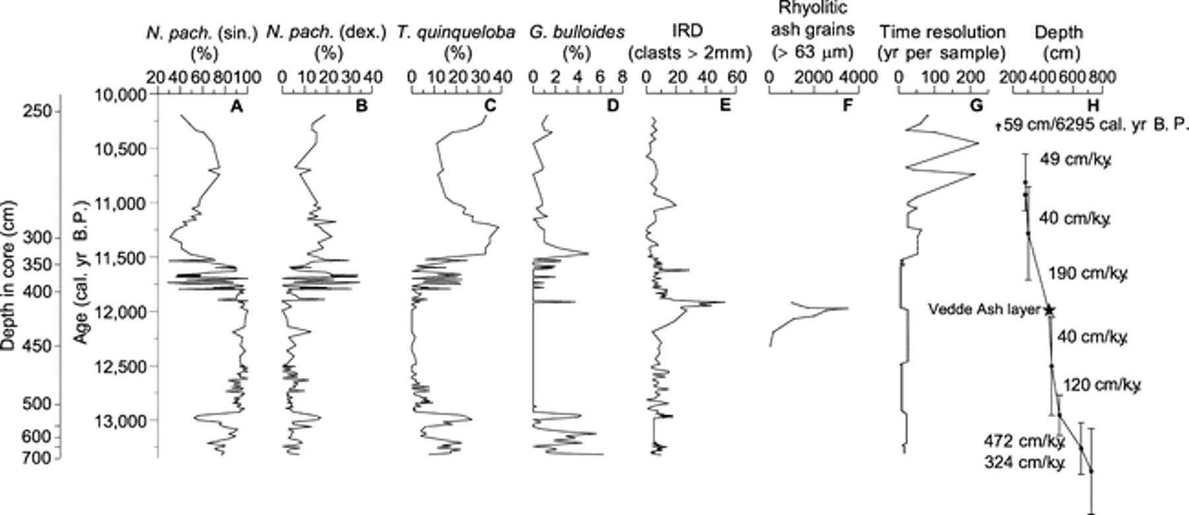
Figure 2. Proxies analyzed from core JM99-1200.
Ebbesen H , Hald M Geology 2004;32:673-676
©2004 by Geological Society of America
Notes:
Figure 2. Proxies analyzed from core JM99-1200. A–D: Planktic foraminifera. N. pach.—Neogloboquadrina pachyderma (sin-—sinistral; dex.—dextral). T.—Turborotalita. G.—Globigerina. E: IRD—Ice-rafted debris. F: Rhyolitic ash grains. Geochemical analysis of rhyolitic grains indicates that they could be correlated to Vedde Ash (cf. Grönvold et al., 1995). Grains have been counted statistically between 425 and 450 cm. Above and below these levels, samples have been inspected for ash grains. G: Time resolution. H: Age model (tephra chronology (Vedde Ash) and accelerator mass spectrometry 14C dates used). Sedimentation rate was calculated by linear interpolation.
Detailed stratigraphic analyses were performed on the core, including:
*classification of planktic foraminifera (A-D). At high latitudes N. pachyderma (sin.) is the dominant species and in many cases the only planktic foraminifera, providing long and continuous downcore isotope records during glacial and interglacial times. (Bauch, D. et al. Marine Micropaleontology 2002;45:83-89)
*identification of ice-rafted debris, IRD, from X-ray radiographs (E) – large lithics indicate IRD events (Heinrich events); these clasts of size > 2mm are visually counted in X-radiographs over a specified depth. The effectiveness of identifying IRD events by visual X-radiograph methods has been challenged, however. (Andrews, J. T. Oceanography 2000;13:100-108)
*counts of rhyolitic ash grains (F)
Vedde Ash layer is Icelandic in origin and provides a framework for tephrachronology. Geochemical analysis of the rhyolitic ash grains indicates that they represent Vedde Ash. The age model was developed through a combination of tephrachronology and ¹⁴C dates found by accelerator mass spectrometry.

Slide 20
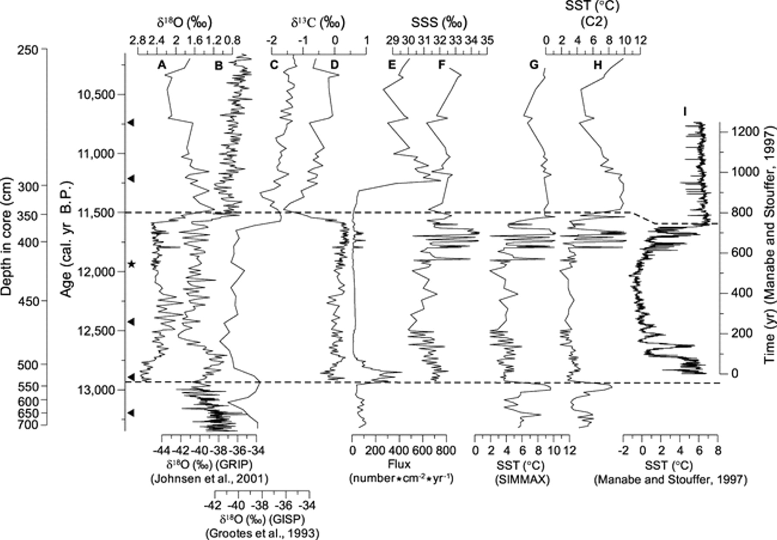
Figure 3. A, D–H: Proxy data from core JM99-1200.
Ebbesen H , Hald M Geology 2004;32:673-676
©2004 by Geological Society of America
Notes:
Figure 3. A, D–H: Proxy data from core JM99-1200. B: δ18O values from Greenland Ice Core Project (GRIP) ice core. C: δ18O values from Greenland Ice Sheet Project (GISP) ice core. Isotopic measurements—δ18O (A) and δ13C (D)—δ18O values were corrected for ice-volume effect (Fairbanks, 1989). E: Flux of planktic foraminifera. F: Sea- surface salinity (SSS) with error of 0.5‰ (Duplessy et al., 1991). G and H: Sea-surface temperature (SST). General deviation of SST is ∼ ±0.96 °C. Temperatures <3 °C are estimated too warm (Pflaumann et al., 1996). I: SST model results from Manabe and Stouffer (1997). Arrows at left axis show dating points used in age model. Asterisk shows Vedde Ash po sition. Dashed lines illustrate beginning and end of cold period (GS-1—Younger Dryas).
N. Pachyderma (sinistral) is planktic foraminifera that lives in the upper 200 m of the water column, and therefore its deltaO18 (A) value is an indicator of both global changes in ice volume and local variations in sea-surface temp (SST) and sea-surface salinity (SSS).
For comparison, deltaO18 signals from GRIP (B) and GISP (C) cores are also included. Straight away we can recognize the difference in the marine core and ice cores; deltaO18 values show nearly mirror images of each other between sea and ice.
The corresponding deltaC13 signal (D) of the planktic foraminifera N. pachyderma sinistral is an indicator for the nutrient and ventilation conditions of the surface waters. A high deltaC13 either indicates high biologic activity (thriving planktic foraminifera) and/or exchange with the atmosphere, but since Figure 2 already showed an abundance of N. pachyderma during the Younger Dryas we can assume it is the former in this case. The proliferation of the planktic forams would explain the low Flux (E) during the Y.D. and the subsequent dramatic increase after the forams died off at the transition to the Holocene. (Bauch, D. et al. Marine Micropaleontology 2002;45:83-89)
The SSS was estimated according to the method of Duplessy et al 1991 (F).
The SST, based on the planktic foraminiferal fauna, was estimated using 2 programs: SIMMAX (G) and C2 (H).
The modeled SST results from Manabe and Stouffer, 1997 were also included (I). Manabe and Stouffer developed a coupled ocean-atmosphere model that predicted the THC response of freshwater discharges to the high latitude belt of the North Atlantic Ocean. The modeled THC weakened in response to the freshwater discharge, which in turn reduced the surface air temperature of the northern North Atlantic.
The coldest interval was between 12.5 and 11.9 ka. Low foram flux (3E) is associated with this time period, as well as reduced sed rates (2H).
Peak in IRD (2E) at end of this cold period has been linked to the onset of deglaciation in the Malangen fjord.
Extreme instability followed the cold interval, from 11.8 to 11.5 ka. SST oscillates between 2 and 10°C on a subdecadal to multidecadal times scale. Looking back to figure 2, and there is obvious affects of this temperature instability on the foram fauna; warm peaks show higher diversity of subpolar species (2B-D) and higher flux.

Slide 21
Ebbesen & Hald Conclusions
The SST fluctuations over the last 300 years of the Younger Dryas reflect shifts in the position of an oceanic front
  Separates cool, less saline and ice-covered water from warmer, saline Atlantic Water
  Cold freshwater introduced as meltwater
Good correlation between reported record in JM99-1200 and modeled THC, SST, and SSS fluctuations of North Atlantic
Ebbesen H , Hald M Geology 2004;32:673-676
Notes:
Good correlation between model and marine sed record indicates that fluctuations of the North Atlantic THC could be what results in the fluctuations of temp seen in the core record.

Slide 22
Speleothems
Speleothems from the Oregon Cave National Monument are used to support the assertion that the abrupt climate change may have been hemispheric or even global (Vacco, 2005) .
Liz

Slide 23
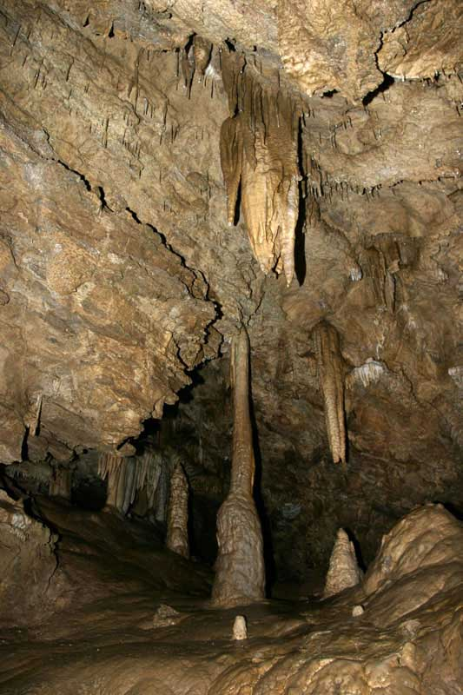

Speleothems
Depositional features in caves
Primarily CaCO₃
Active deposition during glacial-interglacial transitions and interglaciations
Gaps in depositional intervals represent time when groundwater is frozen (Vacco, 2003)
Liz
National Park Service: Oregon Caves National Monument

Slide 24
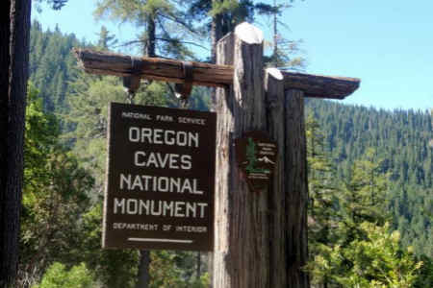
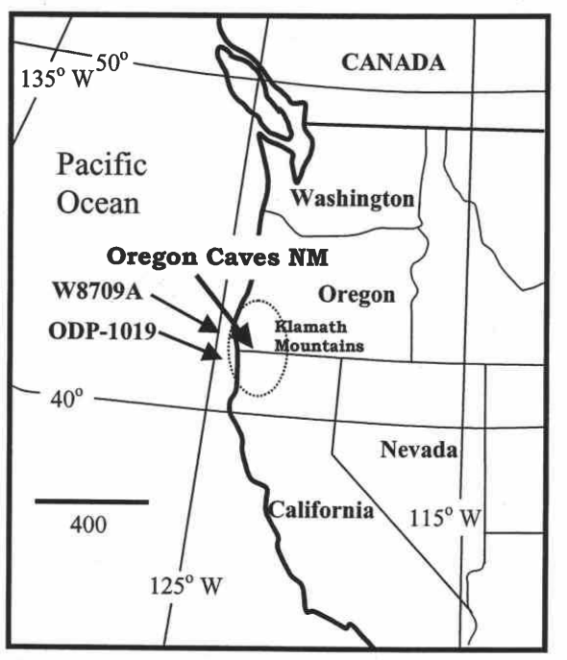
OCNM
Westward facing slopes of Klamath Mountains on path of westerly storm tracks that enter North America
Proximity (65 km) to the Pacific Ocean minimizes terrestrial influences
Elevation of 1100 m above sea level, depth of ~60 m
Triassic marble
Groundwater flows from the surface to the cave on timescales of hours to days
Cave drip water is supersaturated with calcium carbonate, leading to the precipitation of speleothems (Vacco, 2003)
Vacco, 2003
Liz

Slide 25
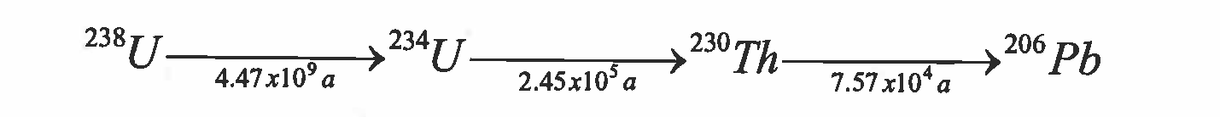

U/Th: Time Scale for Deposition
When water enters a cave and precipitates calcite in the form of speleothems, uranium is incorporated into the calcite lattice
Once the system is closed, the age of calcite precipitation is measurable by U-series disequilibrium dating
Uranium-series dates determine the timing of deposition
Extrapolate for calcite growth rates (Vacco, 2003)
Liz

Slide 26
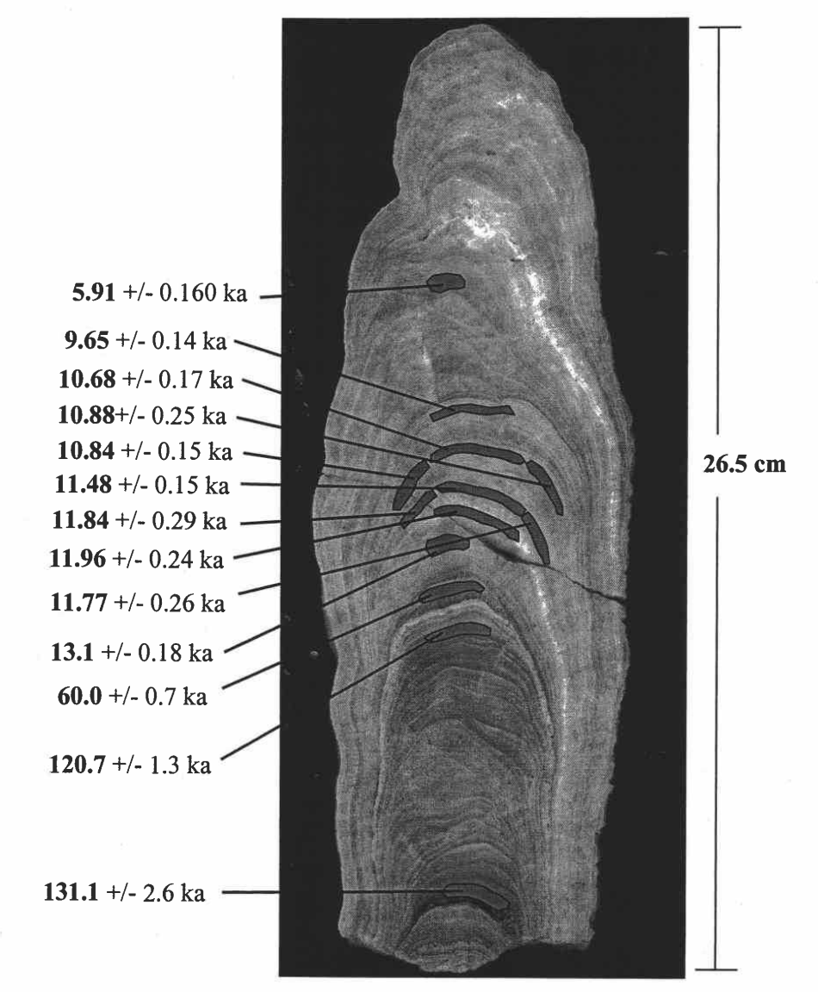
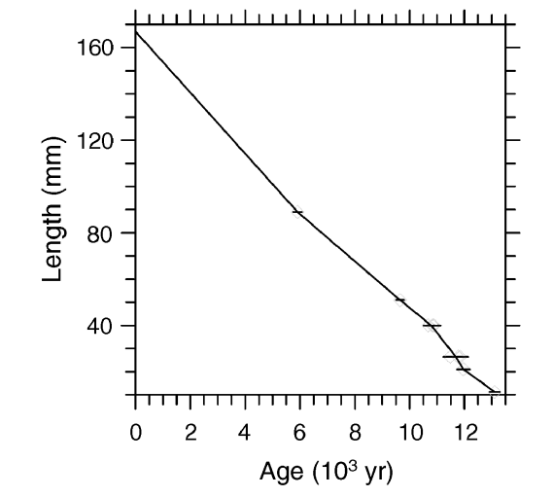
Growth Rates and Dates
Dates reveal that the stalagmite was deposited during three periods: 131 to 120 ka, 60 ka, since - 13.3 ka
Liz
Vacco, 2005
Vacco, 2003

Slide 27
Carbon and Oxygen Isotopes
Slow degassing results in isotopic fractionation between aqueous and solid phases
δ¹³C values (calcite) progressively increase with distance from the source of dripwater, as ¹²C0₂ is preferentially lost by degassing relative to ¹³C0₂
Constant δ¹⁸O values along a single growth band (Vacco, 2003)
Liz

Slide 28
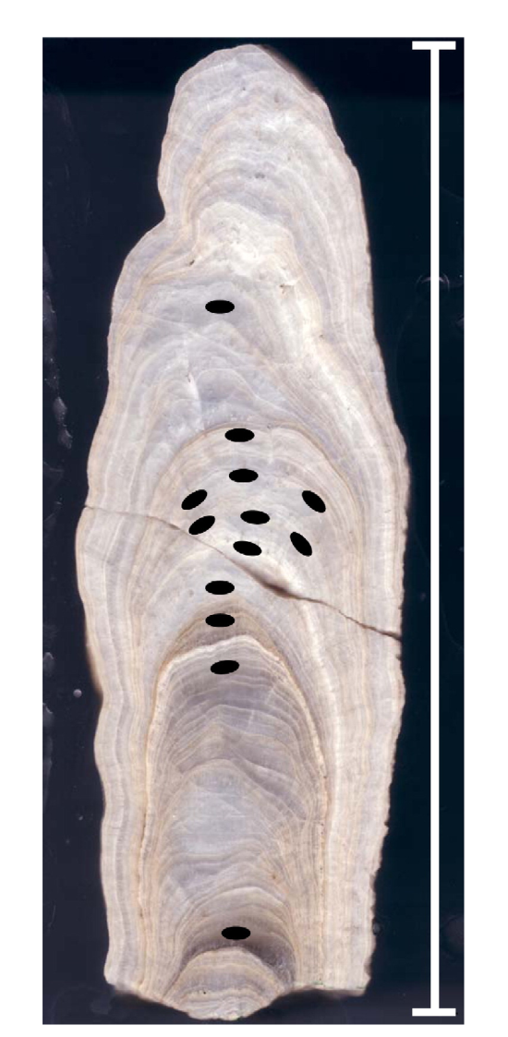
Vacco et al. Conclusions
PNW atmospheric temperatures decreased by up to 4 °C at 13.1-12.9 ka BP
Colder atmospheric temperatures and a constant flux of biogenic C0₂ from 12.8-11.76 ka BP
End of the Younger Dryas event marked by a 3°C warming; an increase in vegetation density lagged this warming by 600 years
Speleothems as evidence for hemispheric cooling during the Younger Dryas, implying rapid transmission of cold temperatures from the North Atlantic to the rest of the globe (Vacco, 2003)
Liz

Slide 29
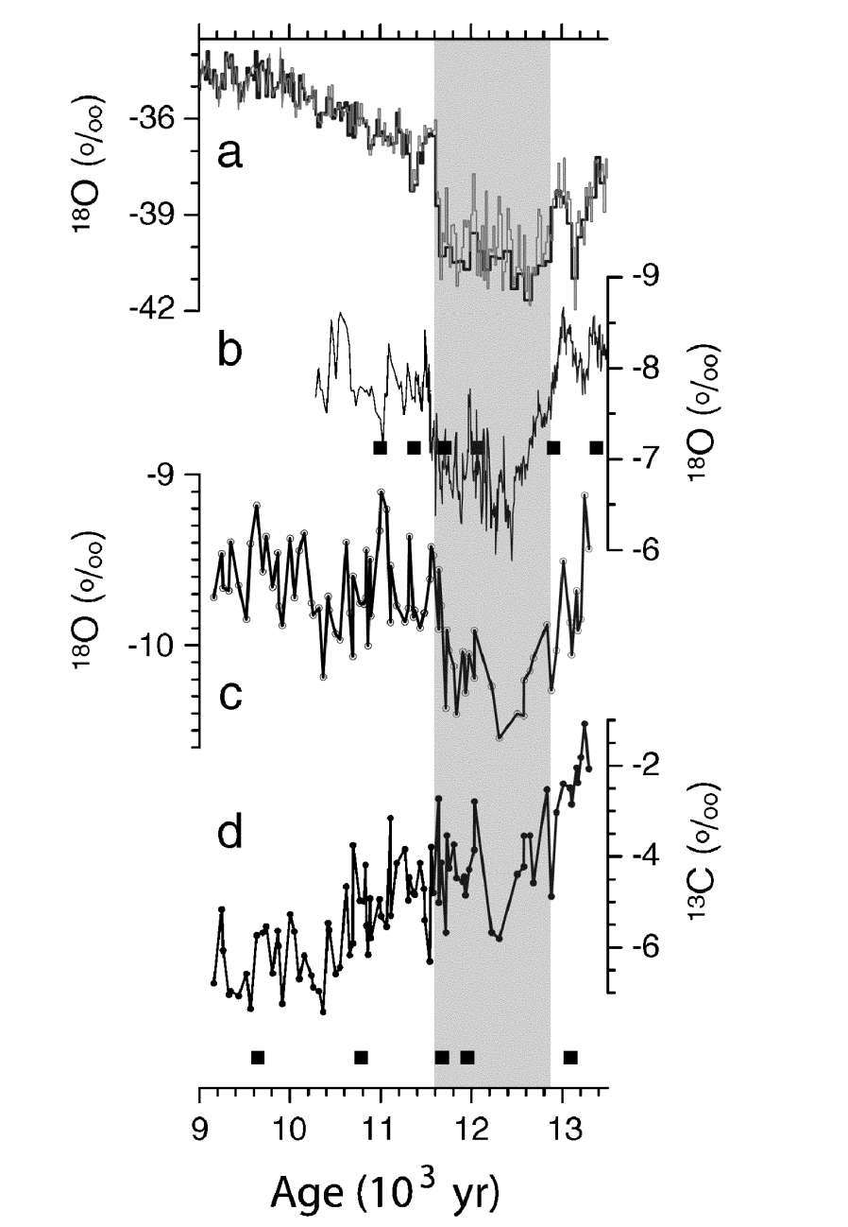
Correlations
Greenland GISP2 δ¹⁸O record
Hulu Cave, China δ¹⁸O record
Oregon Caves δ¹⁸O record
Oregon Caves δ¹³C record
Liz
Vacco, 2005

Slide 30
“Take Home” Message
The coldest interval of Y.D. (12.5 - 11.9 ka) was stable
  Cold temperatures rapidly transmitted from the North Atlantic to the rest of the globe
The last few centuries of the Y.D., however, was extremely unstable
  Fluctuations due to normal salt oscillations in the North Atlantic Ocean, intensified by timely meltwater
  Only reflected in marine record, not ice-core
Climate stabilized again once the transition to the Holocene was completed in 1 abrupt warming event associated with a hemisphere-wide water vapor increase
  Increased vegetation occurred as a result of the transition to the warmer Holocene
K C Taylor et al. Science 1997;278:825-827
Ebbesen H , Hald M Geology 2004;32:673-676
D. A. Vacco et al. Quaternary Research 2005;64:249-256
Notes:
The extreme temp fluctuations are reflected only in the reported marine record, not in the ice-core record. This may be because the ice-core record represents a more integrated, regional temperature signal whereas the marine record represents a more localized temperature signal.
The fluctuations could be magnified by alternating weakening and strengthening of the THC by meltwater increase and decrease, respectively.

Slide 31
References
Ebbesen, H. and Hald, M. Unstable Younger Dryas climate in the northeast North Atlantic. Geology; August 2004; v. 32; no. 8; p. 673–676; doi: 10.1130/G20653.1
Taylor, K. C., et al. The Holocene–Younger Dryas Transition Recorded at Summit, Greenland. Science; October 1997; v. 278; no. 5339; p. 825-827; doi:10.1126/science.278.5339.825
Vacco, D. A., et al. A speleothem record of Younger Dryas cooling, Klamath Mountains, Oregon, USA. Quaternary Research; September 2005; v. 64; no. 2; p. 249-256; doi:10.1016/j.yqres.2005.06.008
National Research Council. Abrupt Climate Change: Inevitable Surprises, US National Academy of Sciences, National Research Council Committee on Abrupt Climate Chang. National Academy Press; 2002; Washington, D.C.; p. 230
Alley, R.B. The Younger Dryas cold interval as viewed from central Greenland. Quaternary Science Reviews; January 2000; v. 19; no. 1-5; p. 213-226
Cuffey, K.M., and G.D. Clow. 1997. Temperature, accumulation, and ice sheet elevation in central Greenland through the last deglacial transition. Journal of Geophysical Research 102:26383-26396.
Whung, P.-Y., et al. Two-hundred-year record of biogenic sulfur in a south Greenland ice core (20D). Journal of Geophysical Research; January 1994; v. 99; no. D1; p. 1147–1156, doi:10.1029/93JD02732
University of Copenhagen. http://www.iceandclimate.nbi.ku.dk/research
Sneed, S. B., et al. An emerging technique: multi-ice-core multi-parameter correlations with Antarctic sea-ice extent. Annals of Glaciology; May 2011; v. 52; no. 57; p. 347-35
Taylor, K., et al. Ice-core dating and chemistry by direct-current electrical conductivity. Journal of Glaciology; 1992; v. 38; no. 130; p. 325-332
Zielinski, G. A. and Mershon, G. R. Paleoenvironmental implications of the insoluble microparticle record in the GISP2 (Greenland) ice core during the rapidly changing climate of the Pleistocene-Holocene transition. Geological Society of America Bulletin; May 1997; v. 109; no. 5; p. 547-559; doi: 10.1130/0016-7606(1997) 109<0547:PIOTIM> 2.3.CO;2
Brook, E. J., et al. Rapid Variations in Atmospheric Methane Concentration During the Past 110,000 Years. Science; August 1996; v. 273: 1087-1091
Broecker et al. A salt oscillator in the glacial Atlantic? 1. The Concept. Paleoceanography; August 1990; v. 5; no. 4;p. 469-477
Bauch, D. et al. Carbon isotopes and habitat of polarplankticforaminifera in the Okhotsk Sea: the ‘carbonate ion effect’ under natural conditions. Marine Micropaleontology; June 2002; v. 45; no. 2; p. 83-89
Andrews, J. T. Icebergs and iceberg rafted detritus (IRD) in the NorthAtlantic: facts and assumptions. Oceanography; 2000: v. 13; no. 3; p. 100-108
Vacco, D.A., 2003, Developing Climate Records from Speleothems, Oregon Caves National Monument, Oregon [Masters Thesis], Corvallis, Oregon State University, 42p.

