Slide 1

Optically Stimulated Luminescence

Slide 2


How does it work?
As sediment [quartz] is transported by wind, water, or ice, it is exposed to sunlight (“bleached”) and zeroed of any previous luminescence signal
Once this sediment is deposited and subsequently buried, it is removed from light and is exposed to low levels of natural radiation from the surrounding sediment (Halfen et al., 2009)
Radiation comes from α, β, γ emitted during the decay of ²³⁵U, ²³⁸U, ²³²Th, ⁴⁰K, and ⁸⁷Rb, and their daughter products, both within the mineral grains and in their surroundings, and from cosmic rays (Mallinson, 2008)
Radiation is absorbed by the crystal lattice upon sediment burial, and over time, excites electrons causing them to migrate within the crystal and become stored in “traps” aka crystal lattice defects (Mallinson, 2008)
In the lab, the sediment is stimulated by blue light, the electrons gather in luminescence sites and energy is released in the form of light
The response is measured and a “simple” calculation derives the age of sediment burial (Wintle, 2008)

Slide 3
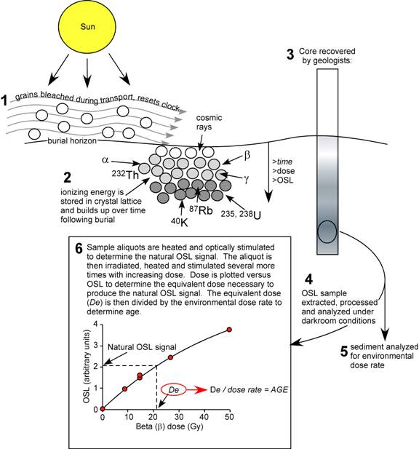
Mallinson, 2008

Slide 4
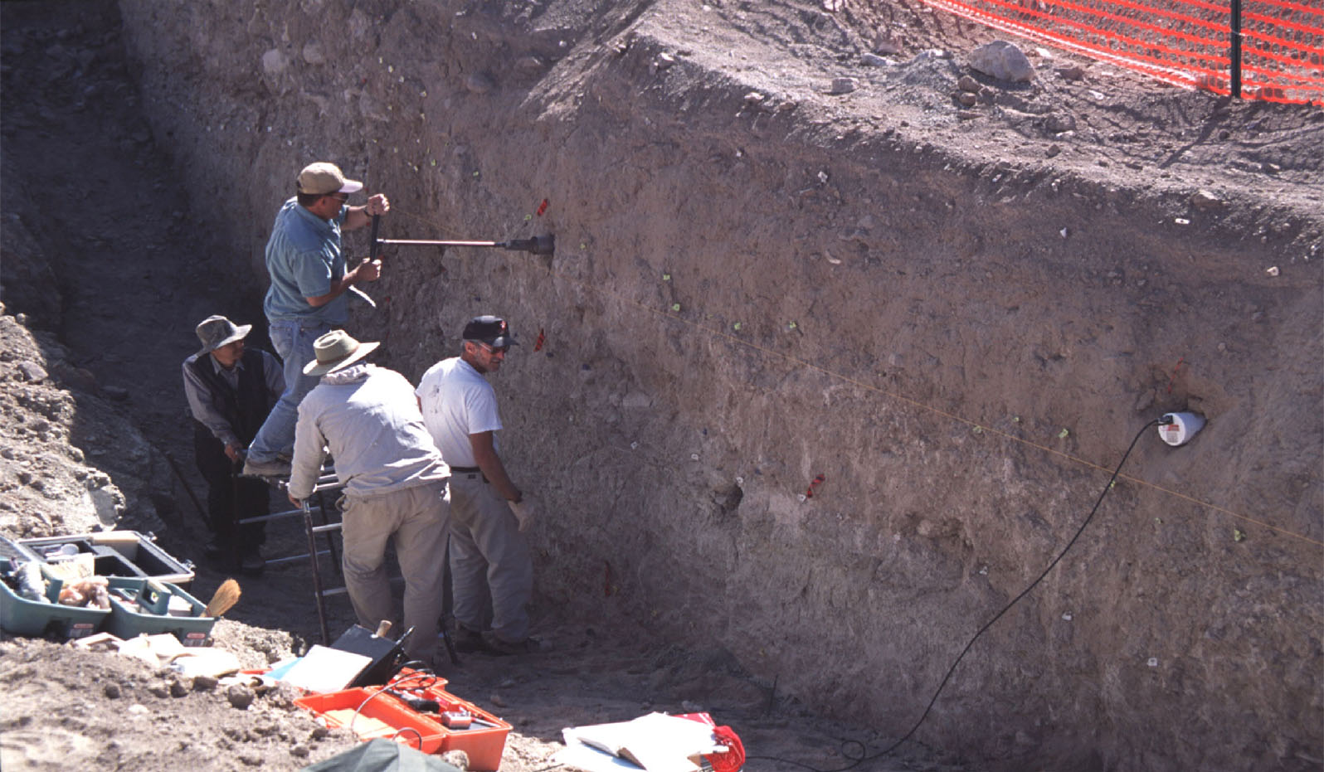
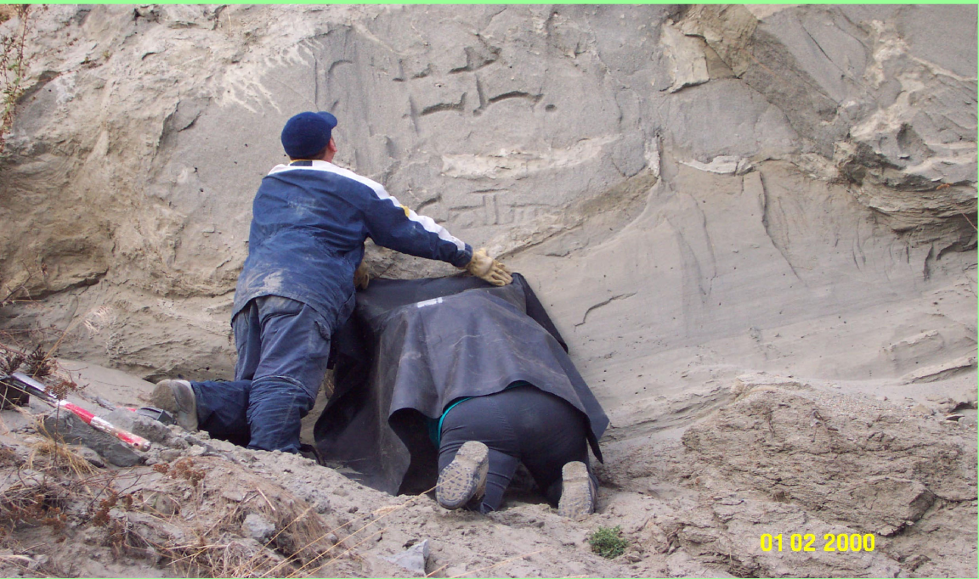
Sample Collection
Sample amount: 10-100 grams for an initial sample with an extra bulk sample of 400-600 grams for moisture measurements, elemental concentrations
Brief heating at 200◦C–400◦C, or a short daylight exposure (in the range of 1 to 100 s) is sufficient to reduce certain electron trap populations to a low level, effectively resetting the OSL dating clock (Rhodes, 2011)
USGS Crustal Geophysics and Geochemistry Science Center http://crustal.usgs.gov/laboratories/luminescence_dating/sampling.html

Slide 5
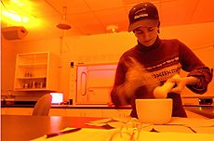
Sample Processing
Samples are processed under dark-room conditions (orange light)
Core ends discarded as light-affected
Typical processing includes:
    Treatment with HCl and H₂O₂ to remove carbonate and organics
    Sieving, heavy liquid (Li- or Na-polytungstate) separation, and (sometimes) magnetic separation to concentrate quartz sands of the appropriate size [different grain sizes in a sample may reflect different transportation/deposition modes (Singhvi, 2001)]
    Etching with HF is performed to remove the outermost “rind” of the quartz grain (Mallinson, 2008)
Approximately 200-250 quartz grains (250-180 µm) were mounted on multiple stainless steel discs and used for analysis (Halfen et al., 2009)
Utah State University

Slide 6
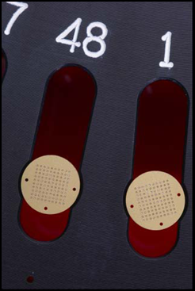
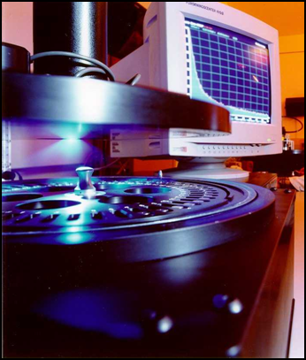
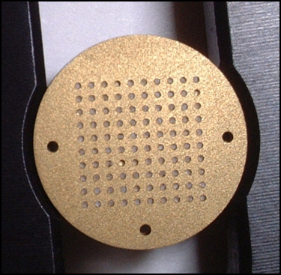
Lab Preparation
Single grain disc made up of a regular array of 100 holes, with one grain per hole

Slide 7
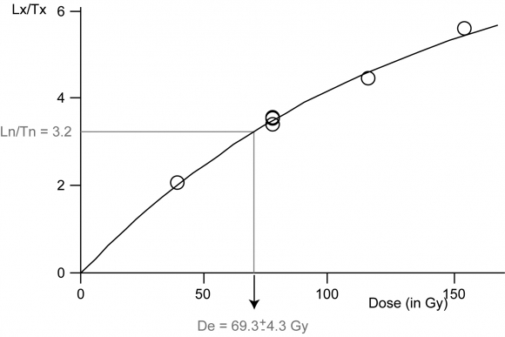
Dose-Response Curve
First, the “natural” luminescence of a sample is measured (Ln)
Sediments are exposed to an external stimulus (blue-green light) and the trapped electrons in crystal lattice defects are released
The released electrons emit a photon of light upon recombination at a luminescence site in the crystal lattice
The sample is given known laboratory doses of radiation, referred to as regenerative doses, and the response is used to generate a luminescence dose-response curve (Lx)
Test doses (Tn and Tx) are run to find any sensitivities and normalize
Cordier, 2010

Slide 8

Age Equation
Age (kyr) $=\frac{Dose Equivalent (Gy)}{Dose Rate (Gy/kyr)}$
The Dose Equivalent is calculated by the intercept of the natural luminescence signal with the generated curve and reflects the radiation energy absorbed since the OSL signal was set to zero
The Annual Dose Rate is calculated as
    The α, β, γ gamma rays arising from the decay of ²³⁸U, ²³²Th and ⁴⁰K in the sample (concentration of radioactivity in the sample and status of the disequilibrium in the decay chains )
    Cosmic ray portion estimated for each sample as a function of depth, elevation above sea level and geomagnetic latitude (Halfen, et al., 2009).
    Average water content estimated through the sample’s antiquity (Singhvi, 2001)
Gy: Gray, SI unit of radiation dose (1 Gy = 1 J·kg⁻¹)

Slide 9
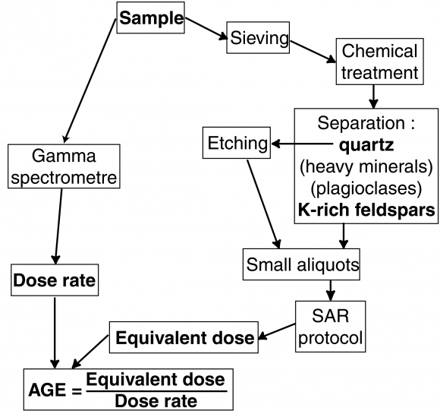
Cordier, 2010

Slide 10
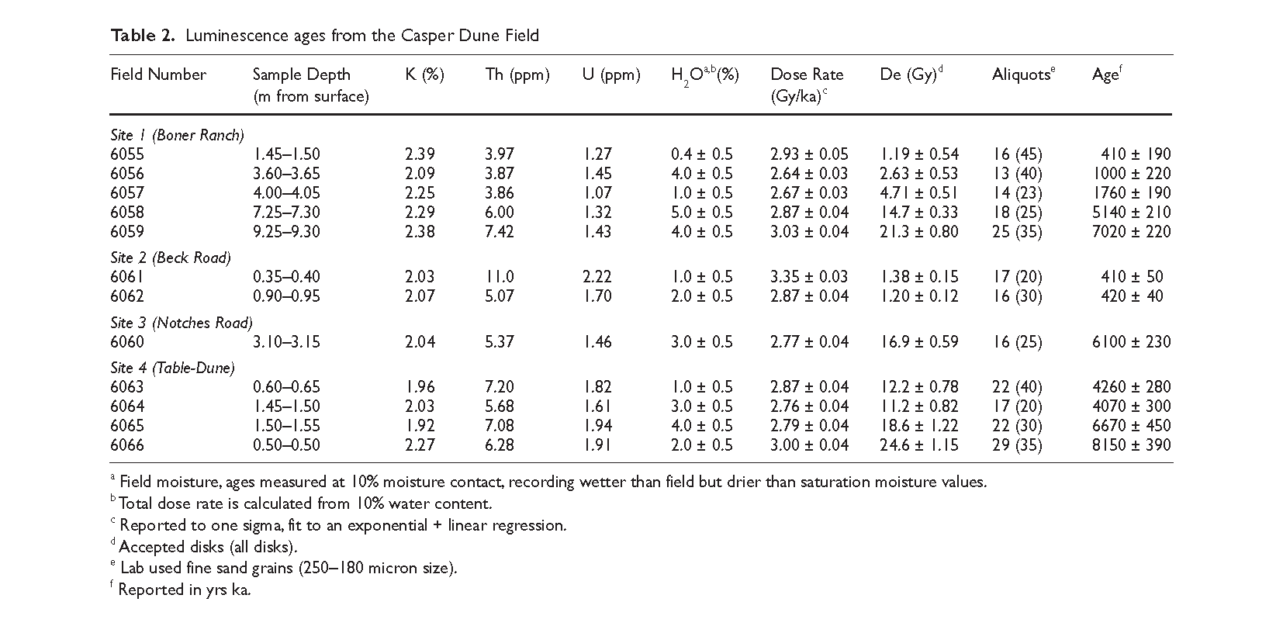
Halfen Table 2

Slide 11
Problems
Two OSL samples 6055, 6056 from site 1 produced questionable ages because of a low number of accepted aliquots. These sediments suffered from unacceptable recycle ratios on equivalent dose analyses and poor test dose responses.
  Several possibilities ruled out (e.g. old samples, inclusions, no common OSL component).
  Three possibilities remain: (1) the last burial of the quartz was recent; (2) some of the quartz has not been through multiple erosion/deposition cycles; (3) the quartz is a mixture of very young aeolian and older partially bleached alluvium. There remain too few aliquots to address these problems (Halfen et al., 2009).
Two OSL sites have same dates but separated by distinctive soil type. Based on site stratigraphy, accepted age of 4.1 ka (6064) as correct, rejected 4.3 ka. (Halfen et al., 2009).

Slide 12
References
Aitken, M.J., 1998, An introduction to optical dating: The dating of Quaternary sediments by the use of photon-stimulated luminescence: Oxford, University Press, 267 p.
Cordier, S., 2010, Optically stimulated luminescence dating: procedures and applications to geomorphological research in France, available at http://geomorphologie.revues.org/7785, accessed 11/07/2012.
Halfen, A.F., Fredlund, G.G., Mahan, S.A., 2010, Holocene stratigraphy and chronology of the Casper Dune Field, Casper, Wyoming, USA: The Holocene v. 20 n. 5, p. 773-783.
Mallinson, D., 2008., A Brief Description of Optically Stimulated Luminescence Dating, available at http://core.ecu.edu/geology/mallinsond/OSL, accessed 11/07/2012.
Rhodes, E.J., 2011, Optically stimulated luminescence dating of sediments over the past 200,000 years: Annual Review of Earth and Planetary Science v. 39, p. 461–488.
Singhvi A.K., Bluszcz, A., Bateman, M.D., Someshwar Rao, M., 2001, Luminescence dating of loess–palaeosol sequences and coversands: methodological aspects and palaeoclimatic implications: Earth-Science Reviews v. 54, p. 193–211.
Stokes, S., Gaylord, D.R., 1993, Optical dating of Holocene dune sands in the Ferris Dune Field, Wyoming: Quaternary Research v. 39, p. 274-281.
Wintle, A.G., 2008, Luminescence dating: where it has been and where it is going: Boreas v. 37, p. 471–482.
Wintle, A.G., 2010, Future directions of luminescence dating of quartz: Geochronometria v. 37, p. 1-7.

