Slide 1
The Holocene climate in the Great Plains (as observed in dune chronology)
Presenter: Erin Dunbar
Assistant: Liz Westby
Notes:
Casper, WY – Alan Halfen
Sand Hills, NE – Xiaodong Miao

Slide 2
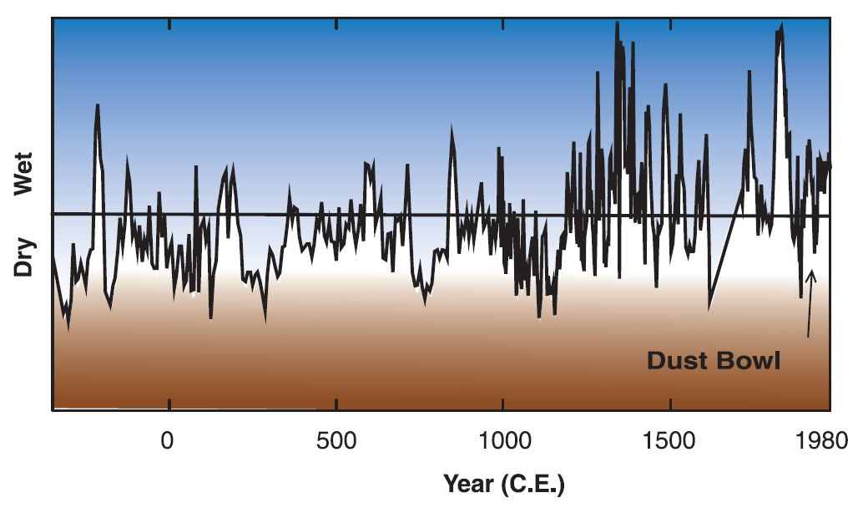
Drought Records

Slide 3
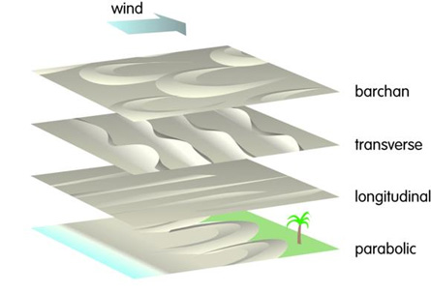
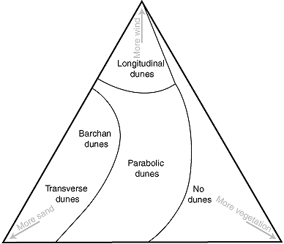
Dune Types
Sparknotes, 2012
University of Maryland, 2010
Notes:
There are four major types of dunes. Barchan dunes are crescent-shaped dunes that are concave downwind, as shown below. Barchan dunes form in places where there is limited sand and a constant wind direction. The parabolic dune is a crescent shaped dune that is concave upwind and forms in areas in which there is some vegetation and a good supply of sand. The longitudinal dune is a linear dune that is parallel to the direction of the wind and forms in areas in which the wind direction is not constant and the supply of sand is moderate to good. Longitudinal dunes can be kilometers in length, and the formation of them is not entirely understood. They are formed in areas in which there is a desert pavement and variable winds. Transverse dunes are linear dunes that are perpendicular to the direction of the wind and are not as long as longitudinal dunes. Transverse dunes form in areas with abundant sand and little vegetation.
http://www.indiana.edu/~geol116/Week11/wk11.htm
Barchan (crescent) dunes [Kazakh - crescent shaped dune]
solitary, cresent shaped dune whose horns point downwind.
forms where sand supply is limited and wind is stong and constant
Traverse dunes:
Imagine a barchan environment but with much more sand, so that the barchans grew to where they fused together into long wavy ridges perpendicular to prevailing wind.
Form in sand rich environments with strong steady prevailing winds.
Parabolic dunes:
Common in costal areas with moderate to abundant sand and winds and some vegetation cover. Picture transverse dunes that become anchored at points by vegetation so that parts of the dune migrate while others are held in place.
Cresent shape but tips point up wind
Longitudinal (or seif) dunes [Seif = Arabic - sword]
long straight ridges more or less parallel to the wind
moderate to low sand supply and strong prevailing winds that change direction frequently. As a result, the dune effectively "doesn't know which way to migrate," and its orientation represents an average of the various wind directions it experiences. Slip and stoss faces change identity frequently.
Saturn's moon Titan is the Solar System's "longitudinal dune central."
http://www.geol.umd.edu/~jmerck/geol100/lectures/34.html
A parabolic dune is similar in shape to a barchan, but its tips point into the wind. Its formation is also influenced by the presence of some type of obstruction, such as a plant or a rock. Just the opposite of a barchan, a parabolic is anchored at its tips by the obstruction, which acts to block the wind, while its main body migrates with the wind, forming a depression between the tips. Because of this formation, parabolic dunes are also known as blowout dunes.
A linear, or longitudinal, dune is one that forms where sand is abundant and cross winds converge, often along seacoasts where the winds from the sea and winds from the land meet and push the sand into long lines. These high, parallel dunes can be quite large: Scientists have recorded linear dunes reaching 655 feet (200 meters) in height and 62 miles (103 kilometers) in length. The crests or summits of linear dunes are often straight or slightly wavy.
A transverse dune also forms where sand supply is great. This dune is a ridge of sand that forms perpendicular to the direction of the wind. The slip face of a transverse dune is often very steep. A group of transverse dunes resembles sand ripples on a large scale.
Read more: http://www.scienceclarified.com/landforms/Basins-to-Dunes/Dune-and-Other-Desert-Features.html#ixzz2BbZI27vT

Slide 4
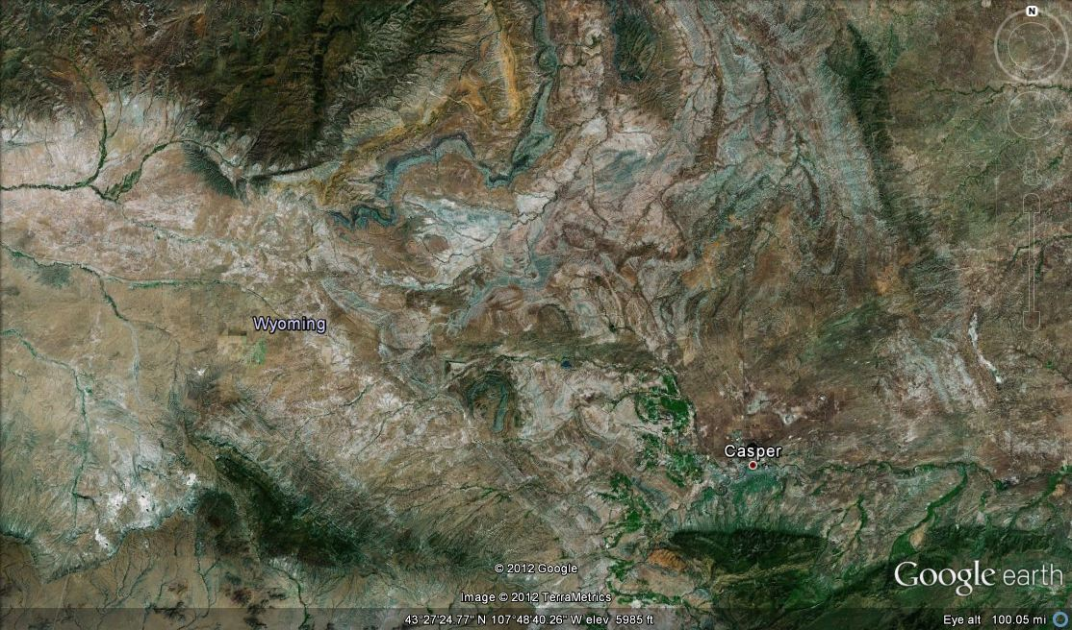
Casper Dune Field
Notes:
Semi-arid, mid latitude steppe
mean temp 7.2 deg C (~45 deg F)
Summer winds from the southwest 7.6 m/s (17 mph)
Winter winds from the west-northwest 7.1 m/s (16 mph)

Slide 5
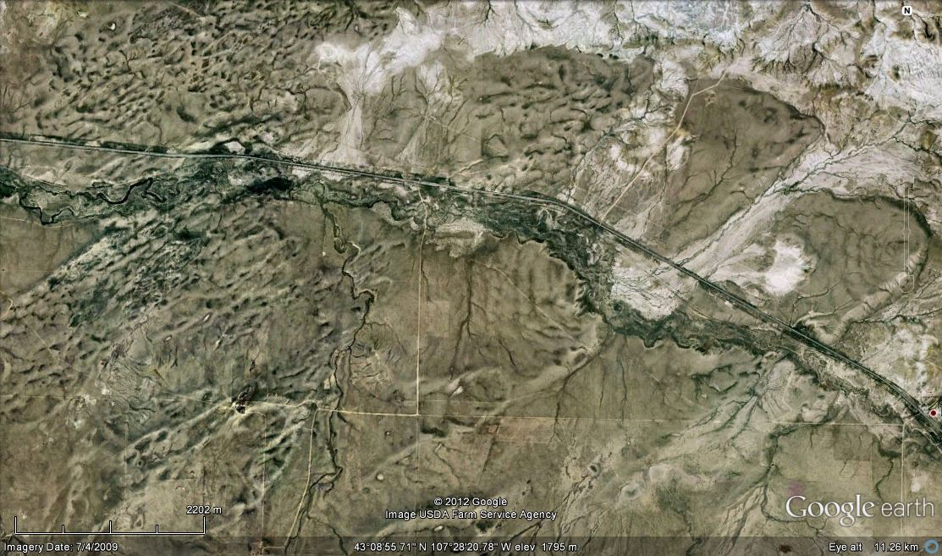
Western Dune Field

Slide 6
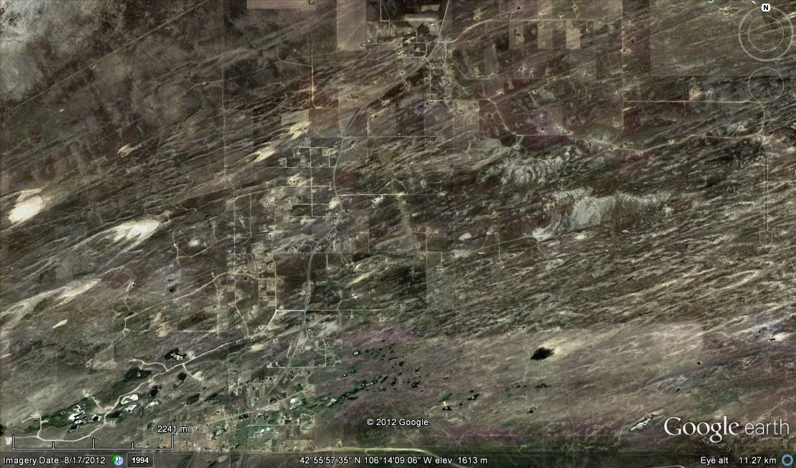
Eastern Dune Field

Slide 7
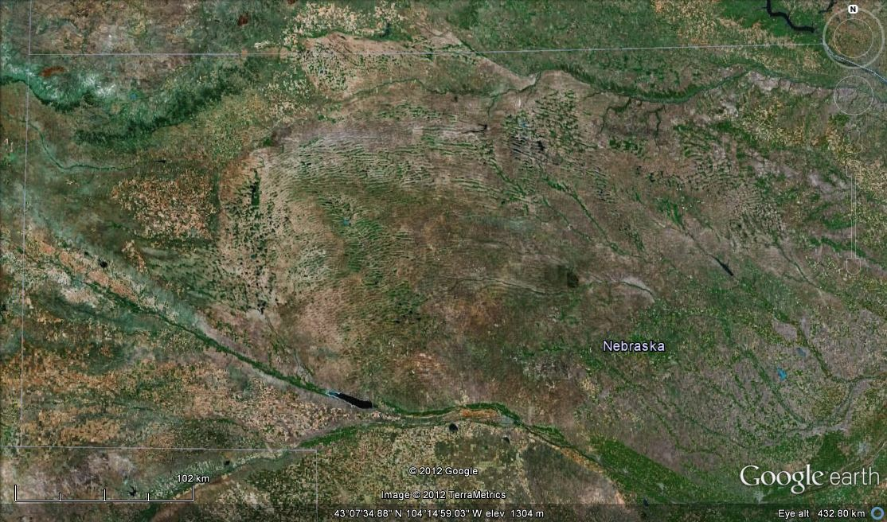
Sand Hills, Nebraska
Notes:
Complex transverse dunes, compound parabolic dunes on the west, linear dunes on the southeast - Loope

Slide 8
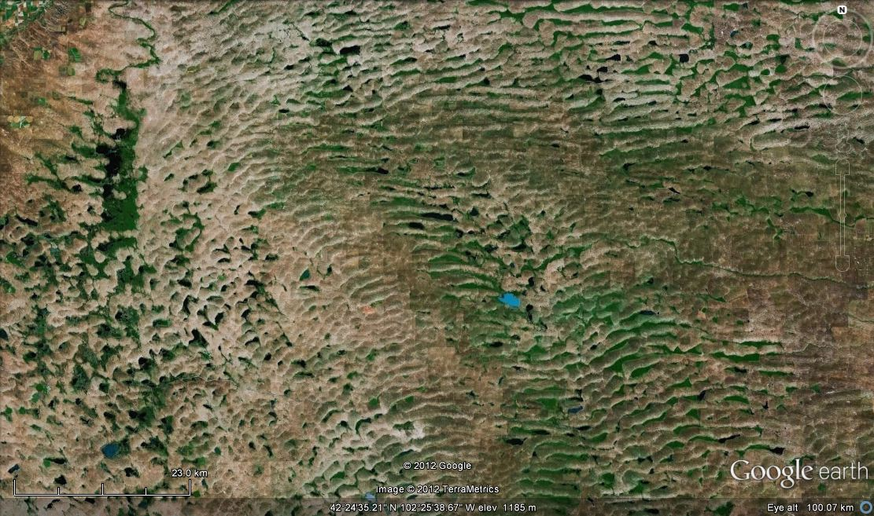
Sand Hills, Nebraska

Slide 9
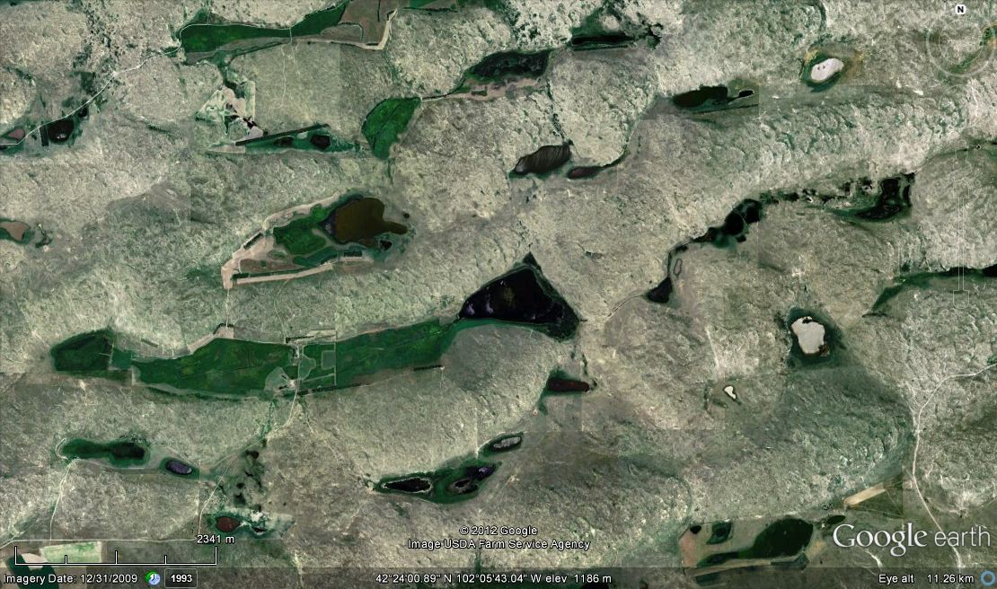
Sand Hills, Nebraska

Slide 10


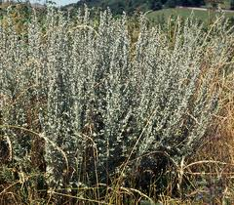
Vegetation
Wheat Grass
Lakehuron.ca, 2012
Artemisia (various)
Discoverlife.com, 2012
Grama Grass
Blueplanetbiomes.org, 2012
Notes:
Stabilization periods and soil formation

Slide 11
Soil Formation
Haplargid (Halfen, 2010)
Arid Climate Soil
  Soils is moist less than 90 days a year, when temperature is above 8⁰ C
  Soil is dry more than half of the time, cumulatively, when the temperature is above 5⁰ C
Argillic Horizon
  Presence of clays
  Greater than parent material
Haplo-
  Minimum horizon development
Notes:
More soil formation during wetter times

Slide 12
Dating Methods
¹⁴C dating of soil
  Organic matter
  Charcoal
  Removed roots and humic acids
Optically stimulated luminescence (OSL)
  Dating the sediments in the dune deposits
  Estimation of burial time
Notes:
Sampled from active blowouts that exposed stratigraphy
Accelerator Mass Spectrometry Radiocarbon Dating Language:
English
English Deutsch Español Français Italiano Português 한국어 日本語 汉语
[Print this Page] [E-mail this Page]
Accelerator mass spectrometry detects carbon 14 in samples.
AMS dating involves accelerating the ions to extraordinarily high kinetic energies followed by mass analysis.
Samples are converted to graphite prior to AMS carbon dating.
Although more expensive than radiometric dating, AMS dating has higher precision and needs small sample sizes.
Aside from archaeology and geology, AMS dating is also used in other fields like biomedical research and ocean sciences research.
There are two techniques in measuring radiocarbon in samples—through radiometric dating and by Accelerator Mass Spectrometry (AMS).
The two techniques are used primarily in determining carbon 14 content of archaeological artifacts and geological samples. These two radiocarbon dating methods use modern standards such as oxalic acid and other reference materials. Although both radiocarbon dating methods produce high-quality results, they are fundamentally different in principle.
Radiometric dating methods detect beta particles from the decay of carbon 14 atoms while accelerator mass spectrometers count the number of carbon 14 atoms present in the sample. Both carbon dating methods have advantages and disadvantages.
Accelerator Mass Spectrometry
Mass spectrometers detect atoms of specific elements according to their atomic weights. They, however, do not have the sensitivity to distinguish atomic isobars (atoms of different elements that have the same atomic weight, such as in the case of carbon 14 and nitrogen 14—the most common isotope of nitrogen).
Thanks to nuclear physics, mass spectrometers have been fine-tuned to separate a rare isotope from an abundant neighboring mass, and accelerator mass spectrometry was born. A method has finally been developed to detect carbon 14 in a given sample and ignore the more abundant isotopes that swamp the carbon 14 signal.
How Does AMS Work?
There are essentially two parts in the process of radiocarbon dating through accelerator mass spectrometry. The first part involves accelerating the ions to extraordinarily high kinetic energies, and the subsequent step involves mass analysis.
There are two accelerator systems commonly used for radiocarbon dating through accelerator mass spectrometry. One is the cyclotron, and the other is a tandem electrostatic accelerator.
AMS Analysis via Tandem Accelerator
After pretreatment, samples for radiocarbon dating are prepared for use in an accelerator mass spectrometer by converting them into a solid graphite form. This is done by converting the samples into carbon dioxide through combustion then to carbon monoxide in the presence of zinc. Via a catalytic reaction with iron, carbon monoxide is further reduced into graphite. Burning the samples to convert them into graphite, however, also introduces other elements into the sample like nitrogen 14.
When the samples have finally been converted into few milligrams of graphite, they are pressed on to a metal disc. Reference materials are also pressed on metal discs. These metal discs are then mounted on a target wheel so they can be analyzed in sequence.
Ions from a cesium gun are then fired at the target wheel, producing negatively ionized carbon atoms. These negatively ionized carbon atoms pass through focusing devices and an injection magnet before reaching the tandem accelerator where they are accelerated to the positive terminal by a voltage difference of two million volts.
At this stage, other negatively charged atoms are unstable and cannot reach the detector. The negatively charged carbon atoms, however, move on to the stripper (a gas or a metal foil) where they lose the electrons and emerge as the triple, positively charged carbon atoms. At this stage, molecules that may be present are eliminated because they cannot exist in this triple charged state.
The carbon atoms with triple positive charge further accelerate away from the positive terminal and pass through another set of focusing devices where mass analysis occurs.
In mass analysis, a magnetic field is applied to these moving charged particles, which causes the particles to deflect from the path they are traveling. If the charged particles have the same velocity but different masses, as in the case of the carbon isotopes, the heavier particles are deflected least. Detectors at different angles of deflection then count the particles.
At the end of an AMS run, data gathered is not only the number of carbon 14 atoms in the sample but also the quantity of carbon 12 and carbon 13. From these data, concentration ratio of the isotopes can be known to allow evaluation of the level of fractionation.
Advantages of AMS Analysis
The greatest advantage that AMS radiocarbon dating has over radiometric methods is small sample size. Accelerator mass spectrometers need only as little as 20 milligrams and as high as 500 milligrams for certain samples whereas conventional methods need at least 10 grams in samples like wood and charcoal and as much as 100 grams in bones and sediments. Accelerator mass spectrometers typically need sample sizes lesser than conventional methods by a factor of 1,000.
Radiocarbon dating is a destructive process. Hence, because of its ability to analyze samples even in minute amounts, accelerator mass spectrometry is the method of choice for archaeologists with small artifacts and those who cannot destroy very expensive or rare materials.
Due to the sensitivity of accelerator mass spectrometers, carbon dating small particles like blood particles, a grain, or a seed have been made possible.
Accelerator mass spectrometry also takes less time to analyze samples for carbon 14 content compared to radiometric dating methods that can take one or two days. An accelerator mass spectrometer has a run time of a few hours per sample.
Lastly, it must be noted that AMS measurements usually achieve higher precision and lower backgrounds than radiometric dating methods.
Disadvantages of AMS Radiocarbon Dating
An accelerator mass spectrometer, although a powerful tool, is also a costly one. Establishing and maintaining an accelerator mass spectrometer costs millions of dollars.
Due to the small sample sizes involved, control of contaminants is also difficult. Rigorous pretreatment is needed to make sure contaminants have been eliminated and will not lead to substantial errors during the carbon dating process.
Other Applications of AMS
Accelerator mass spectrometry is often associated with archaeology and radiocarbon dating, but this technology is also used in other fields of study like biomedical research and ocean sciences research.
Accelerator mass spectrometers are also used in pharmacokinetics, metabolite profiling, toxicology, and microdosing.
AMS is used to determine the natural abundance levels of carbon 14 in oceans as well as to carbon date sedimentary deposits. Accelerator mass spectrometry was used in building a three-dimensional map of carbon 14 distribution in dissolved inorganic carbon.
http://www.radiocarbon.com/accelerator-mass-spectrometry.htm

Slide 13
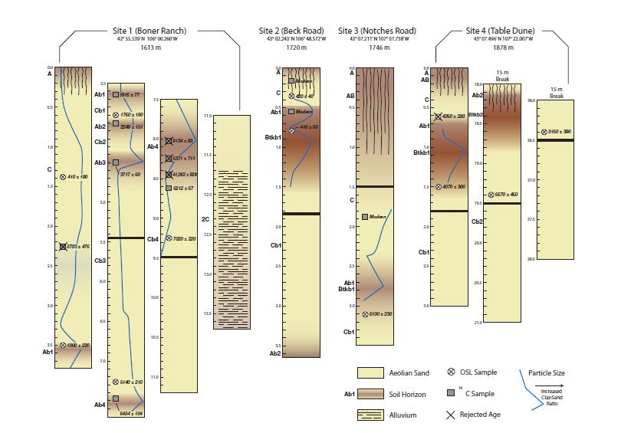
Casper Dune Field Cores

Slide 14
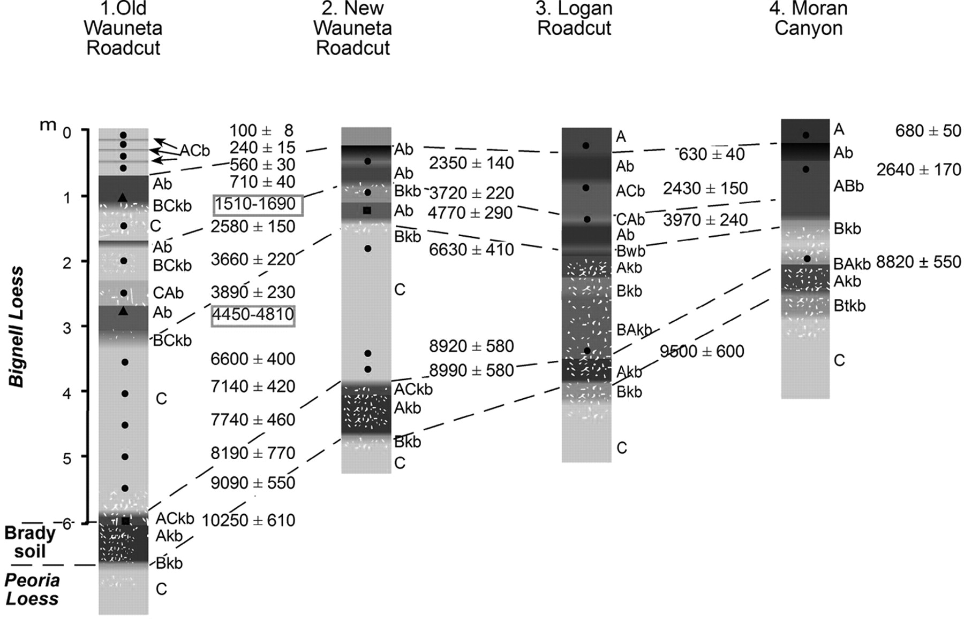
Sand Hills Field Cores

Slide 15
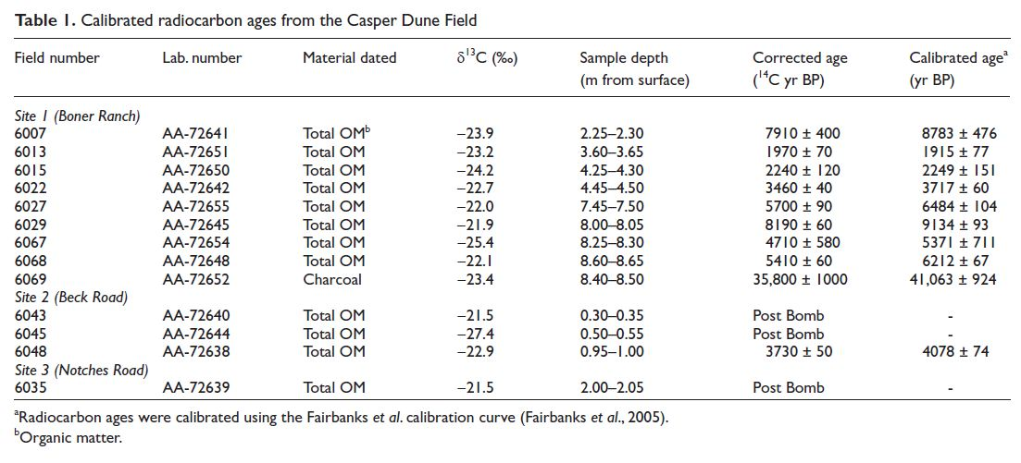
Casper Dune Field Results – ¹⁴C

Slide 16
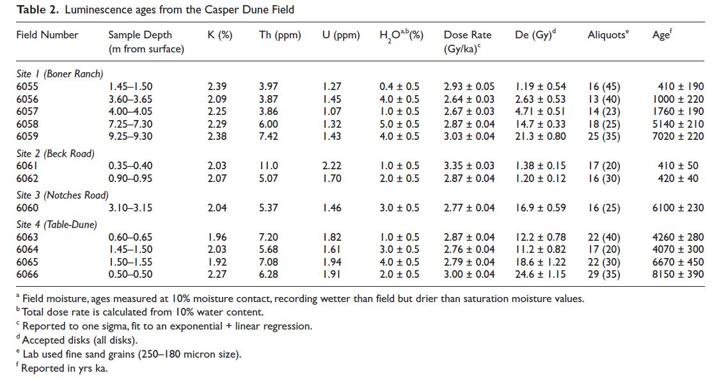
Casper Dune Field Results – OSL

Slide 17
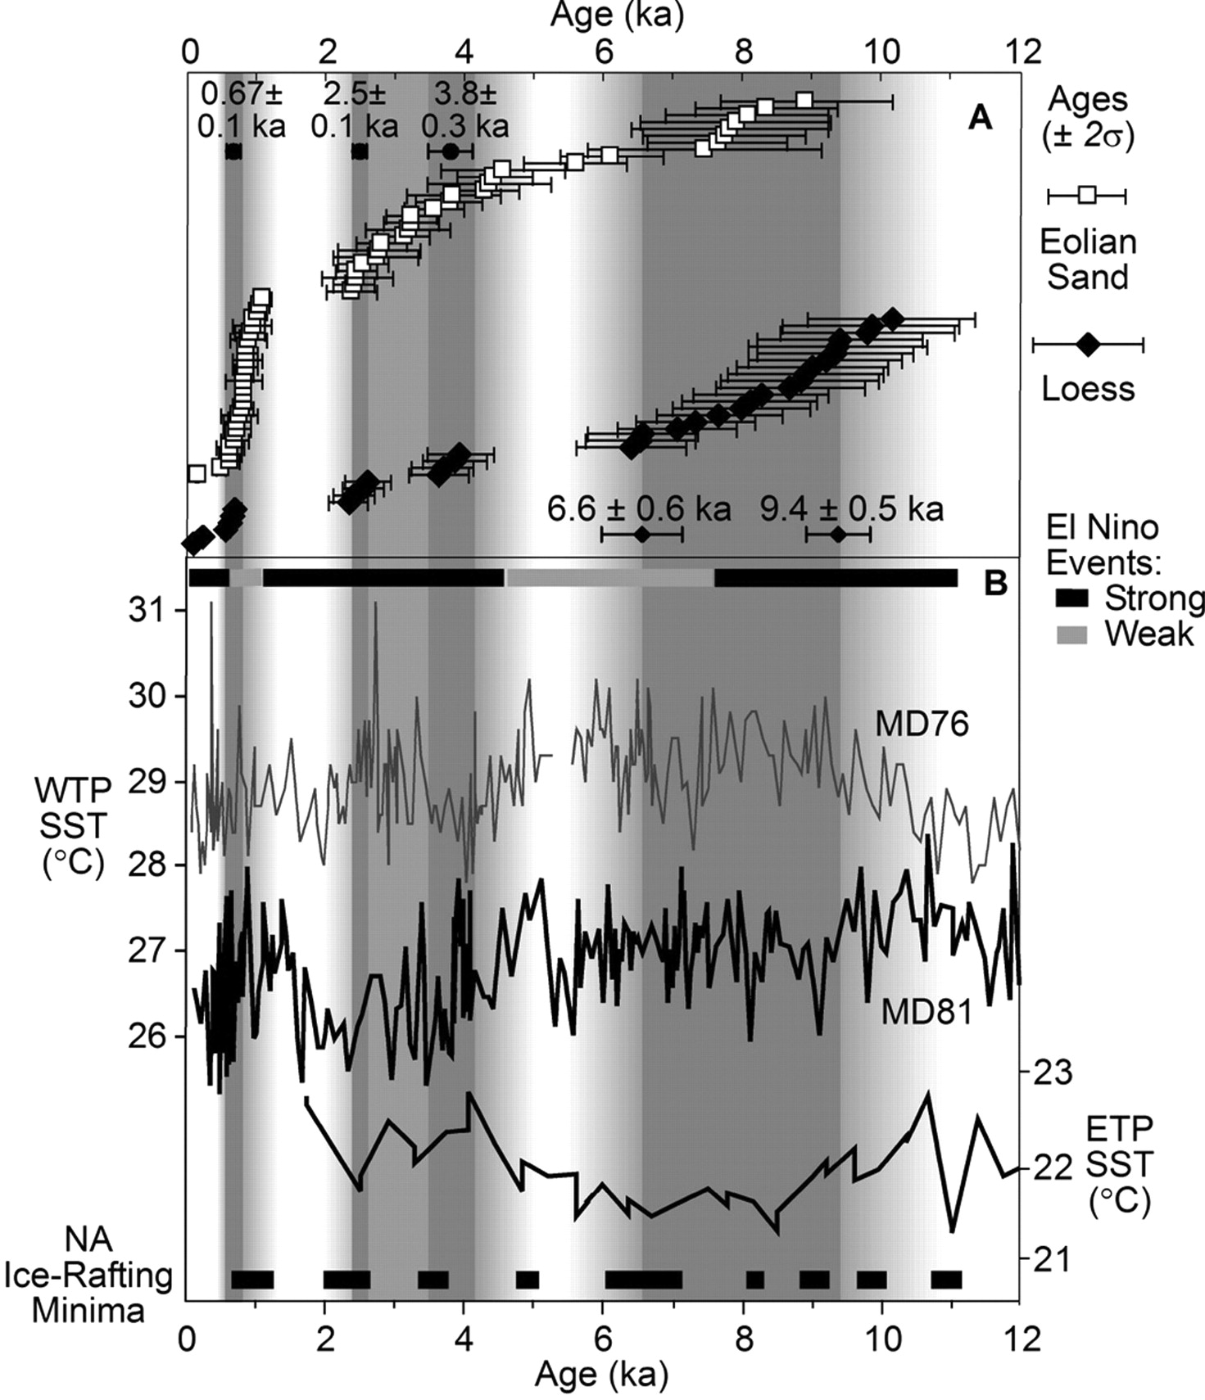
Sand Hill Field Results

Slide 18
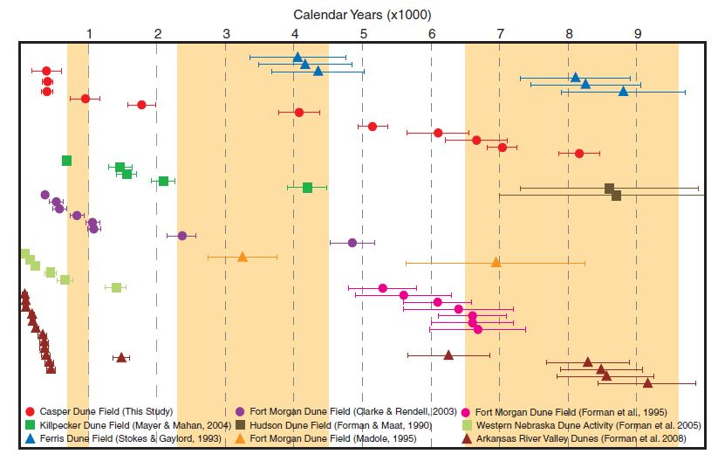
Great Plains Correlation

Slide 19
Significant Dates
Haflen
Miao
Active 10.0 – 6.2 ka
  Active at 8.2 ka
  Stable until 6.1-6.7 ka
  Active in west 6.1 ka
Active 4.2 – 4.1 ka
Active 1.0 – 0.4 ka
Loess accumulation 9.4 – 6.5 ka
Max activity 3.8 ka
Max activity 2.5 ka
Max activity 0.7 ka
Dune activity 4.5 – 2.3 ka (drought)
Last activity 1.0 – 0.7 ka (MCA drought)
Notes:
Paleocrests downwind, indicating multiple activities

Slide 20
References
Birkeland, Peter. Soils and Geomorphology, 3rd ed. 1999. Oxford University Press.
Halfen, Alan, et al. Holocene stratigraphy and chronology of the Casper Dune Field, Casper, Wyoming, USA. 2010. The Holocene 20(50) p. 773-783.
Loope, David and Swinehart, James. Thinking like a dune field; a geologic history in the Nebraska Sand Hills. Great Plains Research 10; Spring 2000: p. 5-35.
Miao, Xiaodong, et al. A 10,000 year record of dune activity, dust storms, and severe drought in the Central Great Plains. Geology, February 2007; v. 35; p. 119-122.

