Slide 1
Spanning the Holocene
Esther Pischel
November 6, 2012

Slide 2
Complexity of Holocene Climate as Reconstructed from a Greenland Ice Core
S.R. O’Brien, P.A. Mayewski, L.D. Meeker, D.A. Meese, M.S. Twickler, and S.I. Whitlow, 1995
High-Frequency Holocene Glacier Fluctuations in New Zealand Differ from the Northern Signature
J.M. Schaefer, G.H Denton, M. Kaplan, A. Putnam, R.C. Finkel, D.J.A. Barrell, B.G. Andersen, R. Schwartz, A. Mackintosh, T. Chinn, and C. Schluchter, 2009
Notes:
Papers are 14 years apart; one represents early research published 2 years after GISP2 was obtained, and one represents expansion on that research.

Slide 3
To assess how humans may affect climate, we must know what the natural variability of the climate is
Notes:
Otherwise how are we going to know what’s human induced?

Slide 4
O’Brien et al. studied various chemical species from the GISP2 ice core to gain insight into how climate has varied in the Holocene before human input
Marine: Na, Cl, Mg, K, Ca
Non-marine (terrestrial): Na, Mg, K, Ca

Slide 5
EOF Analysis
Empirical Orthogonal Function

Slide 6
Many parameters of a system are measured, in this case marine and non-marine chemical species
Several functions are calculated statistically that represent the variation seen between the parameters
The function that can best represent the variation between the parameters (expressed as a percentage of variance) is the principle empirical orthogonal function, or EOF1

Slide 7
Principal EOF (EOF1) for Holocene data only accounted for 36% of the variability of the chemical data
EOF1 for data ranging back 41 ka accounted for 92%

Slide 8
The 41 ka EOF1 represents a predictable system since 92% of the variability in the system can be represented by its calculated EOF1.

Slide 9
Conclusion: Since the Holocene EOF1 represents far less variability than the principle EOF for the data going back to 41ka, it is assumed that changes in source area, source strength, and atmospheric circulation are more complex in the Holocene (much less predictable)

Slide 10
Increases in EOF1 values correspond to winter conditions
These increases occur in quasi -2600-year intervals
These increases are assumed to be due to increased meridional transport

Slide 11

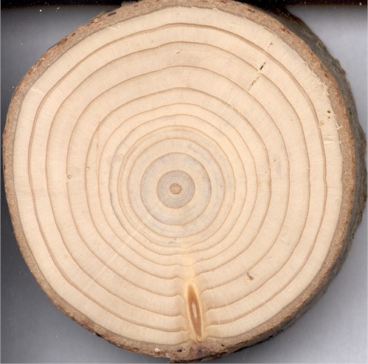
2600-year cycle may be corroborated by δ¹⁴C records from tree rings
Tree rings in turn record changes in solar input
Could the quasi-2600-year cycle be due to variations in insolation?
http://www.johnlwarren.net/formal-properties/113/tree-rings
Notes:
Insert picture of tree rings

Slide 12
0 – 1700 yr B.P. & 5200 – 6000 yr B.P. : GISP2 record shows increased terrestrial Ca:Mg ratio.
Could mean:
Progressively changing environments
Gradual shifts in circulation paths
Ca:Mg ratio changes also seen in western Tibetan ice cores and inland U.S. sites
Notes:
Picture could be starting to emerge here that circulation may be driving these changes. Increased Ca:Mg in concert with increases in marine chemical species (which are believed to reflect changes in meridional atmospheric circulation)

Slide 13
Comparison between GISP2 and other Summit data:
GISP2 chemical record, δ¹⁸O record, and snow accumulation record along with GRIP CH₄ data all show major environmental change at 8400 ka
After 5600 yr B.P., there are few synchronous anomalies between marine-terrestrial chemical species, accumulation rate, δ¹⁸O records, and GRIP CH₄ records.

Slide 14
As the Holocene progressed, environmental change occurred more and more on a regional basis.
These changes may have something to do with changes in atmospheric circulation.

Slide 15
Fast forward 14 years…
Notes:
Insert pic of Delorean

Slide 16
2009: High-frequency Holocene glacier fluctuations in New Zealand differ from the northern signature

Slide 17
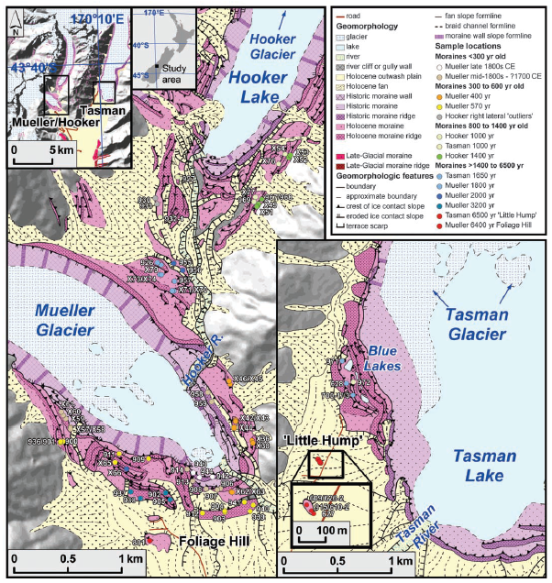
¹⁰Be surface exposure dating was used to date the moraines in the study area
Moraine exposure ages interpreted as dating the completion of moraine formation and thus the termination of a glacier event
Notes:
Insert copy of Fig. 1 from paper, explain that 10Be was used to date the moraines in order to find out when deglaciation took place

Slide 18
¹⁰Be Dating

Slide 19
Notes:
Insert copy of Fig. 2

Slide 20
Comparison between dating results and Northern Hemisphere data
Notes:
Once results were obtained for the date of deglaciation in New Zealand, these records were compared to Northern Hemisphere records

Slide 21
Notes:
3 main conclusions were found….

Slide 22
3 main conclusions:
Notable interhemispheric disparity in the timing of maximum ice extent during the Holocene
Mt. Cook glacial maximum = 6500 yr B.P.
Northern Hemisphere glacial maximum = 1300 to 1860 C.E. (Little Ice Age)

Slide 23
2. Several glacier advances occurred in New Zealand during northern warm periods characterized by diminished or smaller-than-today northern glaciers

Slide 24
3. During periods of “coherence” between northern and southern hemisphere records, there is still a slight difference in maximum glacial extent
“…broad consistency but differing detail of glacial behavior…” that has continued for the past 150 years

Slide 25
Schaefer et al.’s results are not consistent with hypothesis of interhemispheric synchrony of mid-to late Holocene climate change
Also not consistent with a rhythmic asynchrony of climate change
Variations of deep water production between the north and the south would most likely result in strictly antiphased glacier behavior in north and south

Slide 26
Recent studies show that climate models driven by solar changes CAN induce regionally distinct temperature changes like those seen in the Mount Cook moraine chronology
Notes:
Insert clip art of sun

Slide 27
Schaefer et al. hypothesize that regional ocean-atmosphere oscillations may account for the observed glacier fluctuation patterns

Slide 28
Inter-decadal Pacific-Oscillation (IPO)
a.k.a. Pacific Decadal Oscillation (PDO)

Slide 29
IPO has recently been proposed as a lower-frequency pattern within the El Nino Southern Oscillation
Positive phases of the IPO comprise more frequent and more prolonged El Nino events, while negative IPO phases are characterized by a predominance of La Nina conditions.
El Nino conditions bring greater frequency of southwesterly winds, increased precipitation in the S. Alps, and generally cooler air and sea surface temperatures.
La Nina brings more frequent northerly winds, warmer air and sea surface temps and less precipitation in the S. Alps

Slide 30
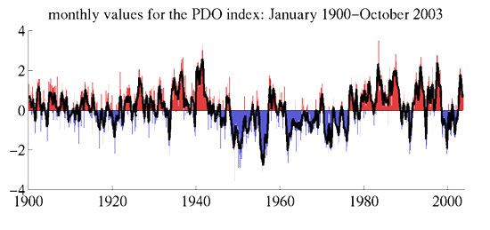
PDO index is calculated by spatially averaging the monthly sea surface temperature (SST) of the Pacific Ocean north of 20˚ N. The global average anomaly is then subtracted to account for global warming.
http://ffden-2.phys.uaf.edu/645fall2003_web.dir/Jason_Amundson/pdoindex.htm

Slide 31
As we’ve moved from the early to late Holocene, there may be ever-increasing importance on regional-scale drivers with regard to climate change.
To accurately assess how climate will change in the future, it will be important to determine the effect that these regional-scale drivers have on the climate and how human influence might change these drivers.

