Slide 1
¹⁰Be
06NOV2012
Kelly Hughes

Slide 2
How is it produced?
Cosmic Ray Spallation:
  ¹⁰Be results from ¹⁶O being bombarded with highly energetic cosmic rays
Muon-reduced reactions:
  Unstable subatomic (-) charged particle interacting w/ target elements
    Stopped muons
    Fast muons
Notes:
Naturally occurring nuclear fission & nucleosynthesis (wikipedia)
During spallation a secondary cosmic ray neutron with sufficient energy hits the target element and one or more particles are ejected from the nucleus leaving the cosmgenic nuclide in the target element’s site in the mineral lattice (Ivy-Ochs & Kober, 2008)
Cosmogenic nuclides are also produced through interactions of muons with the target element (Ivy-Ochs & Kober, 2008)

Slide 3
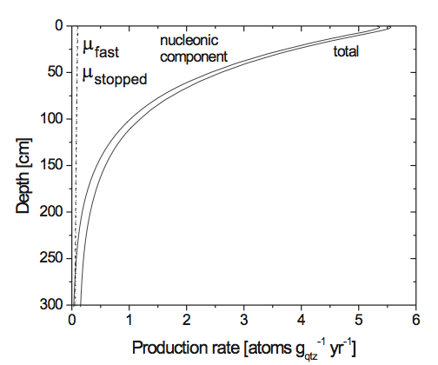
Spallation-Dominated
Fig. 3. Production rate of 10Be in quartz as a function of depth at sea level and high latitude. The total production is a composite of the production by neutron spallation, stopped muons, and fast muons.
Ivy-Ochs & Kober, 2008
Notes:
Production due to spallation decreases exponentially with depth (LAL 1991) (Fig. 3). Muons are less apt to react than neutrons thus they penetrate deeper into the Earth’s surface and production due to muons becomes increasingly important below depths of about 2 m (in a rock of density 2.7 g cm-3).

Slide 4
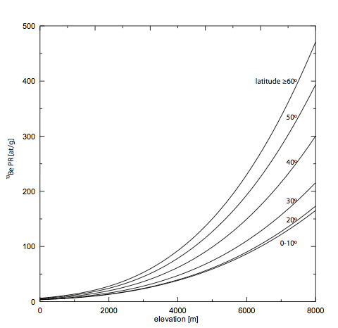
Production Rate
Fig. 2: Production of rate of ¹⁰Be in quartz as a function of geomagnetic latitude and altitude (based on STONE 2000). The production rates have been normalized to sea level and high latitude. At low latitude, production rates are lower than at high latitude. Production rates increase exponentially with increasing altitude.
Ivy-Ochs & Kober, 2008
Notes:
This means that in traversing the atmosphere, the flux of cosmic ray particles first increases (in the first few kilometers) then steadily decreases. Consequently, nuclide production rates in rocks at the surface of the earth are lower at lower altitude.
High solar activity reduces the primary cosmic ray flux. Earth’s magnetic field impedes and deflects particles with lesser energies at lower latitudes. As a consequence cosmic ray intensity and therefore nuclide production is higher at the poles than at the equator. (Ivy-Ochs & Kober, 2008)

Slide 5
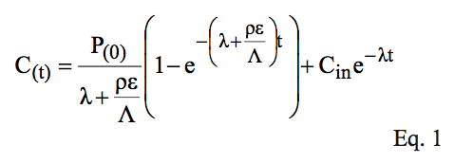
Concentration of ¹⁰Be
Where P₍₀₎ is the production rate at sampling site (atoms/g/yr)
t is the exposure age (yr)
λ is the decay constant (yr⁻¹)
ρ is the density of the rock (g/cm³)
ε is the erosion rate (cm/yr)
Λ is the attenuation length, length at which the probability has dropped to 1/e that a particle has not been absorbed (g/cm²)
C_{in} is the inherited nuclide concentration (atoms/g)
Ivy-Ochs & Kober, 2008
Notes:
Increasing prod rate increases conc
Increasing decay constant decreases conc
Increasing density decreases conc
Increasing erosion rate decreases conc
Doubling the grouped term: 1 – e^(grouped term) will increase but not at a comparable rate to how it will half the production term

Slide 6
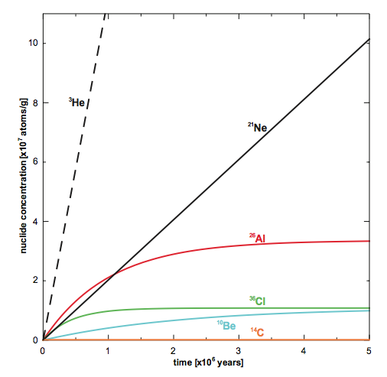
Secular Equilibrium
Fig. 5: Increase in concentration of the radionuclides ¹⁰Be, ²⁶Al, ³⁶Cl and the stable nuclides ³He and ²¹Ne with time. Secular equilibrium, where production of radionuclides equals radioactive decay, is approached after 3-4 half-lives. The secular equilibrium concentration sets the limit of the maximum exposure age that can be determined with a given radionuclide.
Ivy-Ochs & Kober, 2008

Slide 7
Method of Measurement
Accelerated Mass Spectrometry
  Pure quartz is obtained by selective chemical dissolution in hot ultrasonic bath and/or on shaker table
  Carrier of 9Be (0.5 mg in soln) added to pure quartz mineral separate
  Completely dissolved with concentrated HF and HNO3
  Be separated and purified with ion exchange and selective pH precipitations
  Ratio of ¹⁰Be/⁹Be relative to a standard

Slide 8
Why Date Moraines?
Moraines record glacier extent
Moraine dates can construct a chronological structure to past glacier fluctuations

Slide 9
Why ¹⁰Be?
Well-constrained production rate
Widely applicable age range (10¹ to 10⁶ yrs)
Notes:
On the order of tens to millions of years

Slide 10
Why target greywacke boulders?
Greywacke: poorly sorted sandstone, high quartz content
  Quartz is ubiquitous and highly resistant to weathering
  Quartz can be cleaned of the meteoric (atmospheric) ¹⁰Be
Large boulders are more stable than smaller clasts
  Toppling/shifting can result in inaccurate ages
Notes:
Moraines are susceptible to instability and degradation over time, thus, samples must be chosen carefully.

Slide 11
Improvements to the ¹⁰Be Method?
Pinning down an accurate half-life; 1.51 Myr and 1.34 Myr both published
Combining nuclides checks for continuous exposure vs. intermittent coverage

Slide 12
Reference
Ivy-Ochs, S. and Kober, F. Surface exposure dating with cosmogenic nuclides. Journal of Quaternary Science. 2008. v. 57. no. 1-2. p. 179-209

