Slide 1
Northern Hemisphere charcoal index
Kelly Hughes
27Nov2012

Slide 2
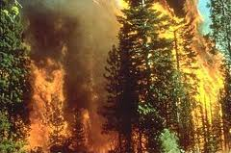
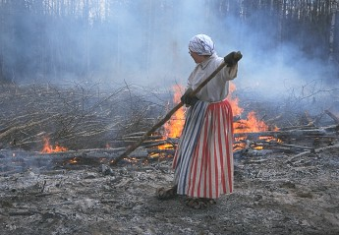
Proxy for Fire
Transformed Charcoal Influx used for indicating:
  Wildfires (natural)
  Deforestation fires (anthropogenic)
v
hdg
en.wikipedia.org/wiki/Wildfire
www.outdoors.fi/destinations/otherprotectedareas/telkkamaki/sights

Slide 3
Charcoal
Carbonized material from incomplete combustion of organic matter
Chemically stable & preserves well
Brittle in handling & sample prep
Can be deposited in nearby lakes during/after fire
Schlachter, K. J., 2005

Slide 4
Proxy History
Until 1990s: examination of microscopic charcoal in samples prepared for pollen analysis
  3 Limitations:
    Pollen samples usually spaced out, leaving unanalyzed sediment
    Charcoal particles can fracture during pollen prep, giving a false number of microscopic particles
    Source area very large; good for regional picture of past fire, but obscures local picture
Schlachter, K. J., 2005

Slide 5
Proxy Today
Contiguous intervals of measurement
Sample prep not as involved as for pollen analysis – less chance of fracture
Bigger charcoal particles are deposited locally vs. distantly deposited microparticles
Schlachter, K. J., 2005

Slide 6
Proxy Today
“Macroscopic” charcoal particles analyzed:
  > 125 μm (most widely accepted)
  Lake sediments
    Small, deep, and closed lakes are best
      Accumulation of distant fire sources is proportional to surface area of lake
      deepest part of the lake is cored because charcoal is focused by currents and sediment slumping
      Closed lakes reduce noise caused by fluvial addition/subtraction of charcoal
Schlachter, K. J., 2005

Slide 7
Macroscopic
“In one study, charcoal accumulation in small lakes following the 1988 fires in Yellowstone National Park indicated that charcoal particles >125 μm diameter were abundant in sites <7 km from the fire (Whitlock & Millspaugh, 1996)” (Whitlock, C. & Larsen, C., 2002)

Slide 8
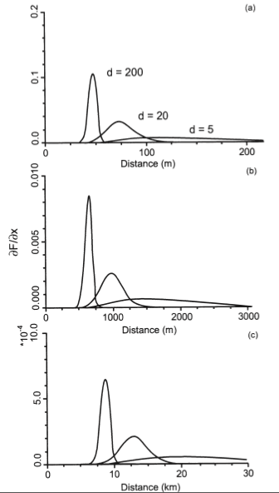
Distance of Deposition from Fire Source as a Function of Particle Size
Relationship between distance from the base of a fire’s convective column and the amount of charcoal deposited as determined by theoretical models for charcoal particles with diameters of 200, 20 and 5 μm and convective columns with a height of (a) 10 m, (b) 100 m, and (c) 1000 m. (after J. S. Clark, 1988a). Notice a theoretical “skip distance” between the fire and the first deposition of charcoal.
Whitlock, C. & Larsen, C., 2002

Slide 9
Methods
Sediment core (piston, percussion, vibracorer)
Lab analysis: identify & quantify charcoal
  Sieving (most common): metal mesh sieves (125 μm)
  Thin sections
  Combustion
  Automatic imaging
Schlachter, K. J., 2005

Slide 10
Charcoal Index
Charcoal indices are normalized (transformed) charcoal accumulation/influx measurements
  Z-scores = (measured sample – mean)/standard deviation
    Charcoal indices fall within ~ -0.6 to 0.6; the greater the magnitude of the z-score, the farther from the mean or baseline level of charcoal
      (+) more fire than normal
      (-) less fire than normal

Slide 11
Marlon, J. R., et al., 2008
“We find that global biomass burning declined from AD 1 to 1750, before rising sharply between 1750 and 1870. Global burning then declined abruptly after 1870. The early decline in biomass burning occurred in concert with a global cooling trend and despite a rise in the human population. We suggest the subsequent rise was linked to increasing human influences, such as population growth and land-use changes. Our compilation suggests that the final decline occurred despite increasing air temperatures and population. We attribute this reduction in the amount of biomass burned over the past 150 years to the global expansion of intensive grazing, agriculture and fire management.”

Slide 12
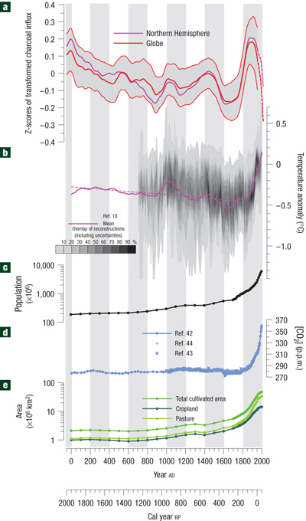
Northern Hemisphere vs. global charcoal influx for last 2000 yrs
a. Reconstruction of global (red line) and Northern Hemisphere (purple line) biomass burning with confidence intervals based on bootstrap resampling by site. A dashed line is used to represent increased uncertainty in late twentieth century changes in biomass burning. b. Reconstructions of Northern Hemisphere climate with mean values (purple line) of available reconstructions, trend line (dotted line) for first part of record and overlap of uncertainty ranges of ten Northern Hemisphere temperature reconstructions after AD 700 (grey shading). c. World population from the HYDE 3.0 database. d. Atmospheric CO2 concentration. e. Global agricultural land cover30.
Marlon, J. R., et al., 2008

Slide 13
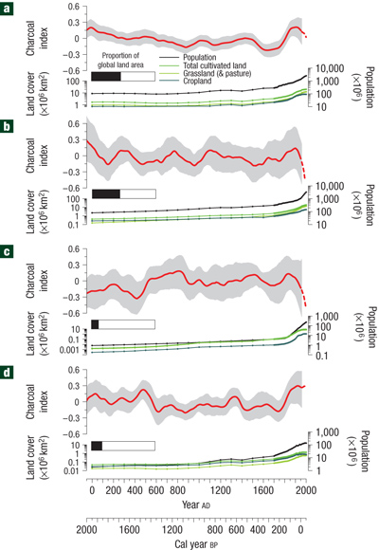
Regional Charcoal Indices for past 2000 yrs
Changes in biomass burning (as in Fig. 1) with land-cover change30, and proportion of global ice-free land area, for northern extratropics (>30° N) (a), tropics (30° N to 20° S) (b), southern extratropics (>20° S) (c) and the northern high latitudes (>55° N) (d). The composite records are based on at least 10 sites per region and thus should reveal the dominant patterns that reflect processes operating at large spatial scales (see Methods section).
Marlon, J. R., et al., 2008

Slide 14
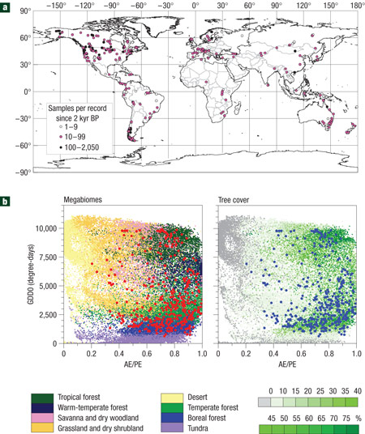
Existing Charcoal Records
a. Locations of charcoal records and number of samples over the past 2,000 years (see Methods section). Mean sampling density is one sample per 70 years. b. Distribution of records in bioclimate space showing locations plotted against growing degree-days above 0 °C (an index of effective warmth during the growing season) and the ratio of actual to equilibrium evapotranspiration (an index of effective moisture), with remotely sensed tree cover and modelled biome shown for comparison.
Marlon, J. R., et al., 2008

Slide 15
References
Schlachter, K. J. Macroscopic Sedimentary Charcoal as a Proxy for Past Fire in Northwestern Costa Rica. Master’s Thesis, Univ. of Tennessee. (2005)
Whitlock, C. & Larsen, C. Tracking Environmental Change Using Lake Sediments. Developments in Paleoenvironmental Research Vol. 3. pp 75-97. (2002)
Marlon, J. R., et al. Climate and human influences on global biomass burning over the past two millennia. Nature Geoscience Vol. 1. pp 697 – 702. (2008)

