Slide 1
Sea level jump with the 8200 year event

Slide 2
Using the Stratigraphic Record
Cores from the sediments of deltas examined for peat, mud, and soils
Transgressive sequences
Determine the paleoenvironment
  Peat formation
  Depositional processes
Carbon dating
Elevations & Surveying
Notes:
Peat formation between the mean sea level and mean high water – intertidal zone

Slide 3
Where to sample
Best Holocene record in large prograding deltas
Need microtidal settings for high resolution
Tectonically stable through the Holocene
Mississippi delta and Rhine-Meuse delta

Slide 4
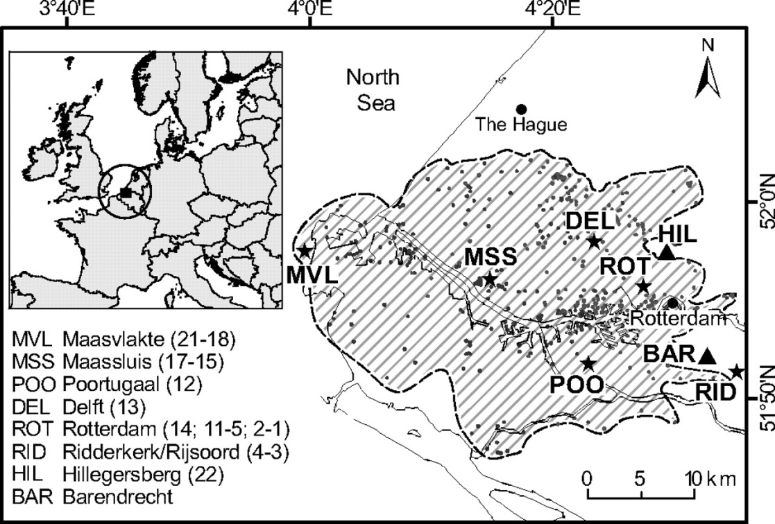
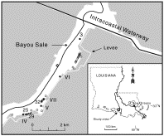
Locations
Yong-Xiang, 2011
Hijma, 2010

Slide 5
Rhine-Meuse Delta
Preservation of sediments 13-25 m depth (bsl)
Average age 8450 ± 44 yr BP
  Early 8385 ± 16 yr
  Late 8522 ± 37 yr
Top of peat layer
  Change in elevation 4.06 ± 0.5 m in record
    2.11 ± 0.89 m for sea level rise two events
  Change in age 195 ± 68 yr
~3 m ± 1.25 m sea level equivalent, 70 % of sea level rise observed
100 years before Mississippi?

Slide 6
Mississippi Delta
Intertidal range (current average 0.47 m)
Agglutenated taxa, followed by calcareous forams
Short pulse of near instantaneous sea level rise
  8.18 – 8.31 ka
  Mean elevation difference 0.33 ± 0.23 m
  Deeper stratigraphy, older range 8.54 – 8.38 ka
Assumed fingerprint of 0.25
  0.8 – 0.22 m of sea level rise 0r sea level equivalent
  Smaller than Rhine-Meuse study
Notes:
Global mass balance data are transformed to sea-level equivalent by first multiplying the ice thickness (meters) lost to melting by the density of ice (about 900 kilograms per cubic meter), to obtain a water equivalent thickness, and then multiplying by the surface area of these "small" glaciers (about 760,000 square kilometers)

Slide 7
References
Hijma, M.P., 2010, Timing and Magnitude of the Sea-level Jump Precluding the 8200 yr Event, Geology 2010;38;275-278
Yong-Xiang, Li et al, 2011, Synchronizing a Sea-level Jump, Final Lake Agassiz Drainage, and Abrupt Cooling 8200 years ago, Earth and Planetary Science Letters 315-316 (2012) 41-50.

